Slide 1
OELA/ORELAP Environmental Laboratory Conference May 9th, 2019

Slide 2
Welcome Oregon Environmental Laboratories!
Notes:
OELA organizes this meeting “periodically” to facilitate the exchange of information with ORELAP and TNI. Again this year we have Jerry Parr, the Executive Director of The NELAC Institute.

Slide 3
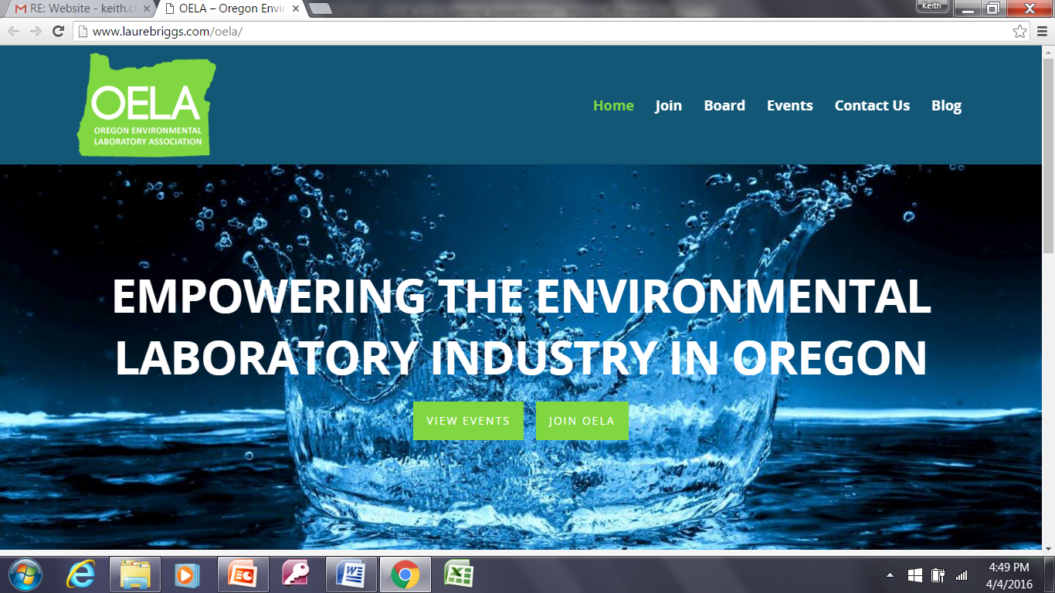
Notes:
oelaonline.com
Persons residing or employed in the State of Oregon who are engaged in the operation of or who are employees of an environmental laboratory, or who are engaged in providing support or services to environmental Labs.

Slide 4
OELA Board
Rory White, President
Kim Ramsey, Vice President
Beth Myers, Secretary/Treasurer
Bill Michalek, OTAC Representative
Dennis Morgan
Jan Wilson
Sherri Miyazaki
Jennifer Shackelford
Kyle Grogan
Marsha Farooqui
Gary Ward
Michelle Miranda

Slide 5
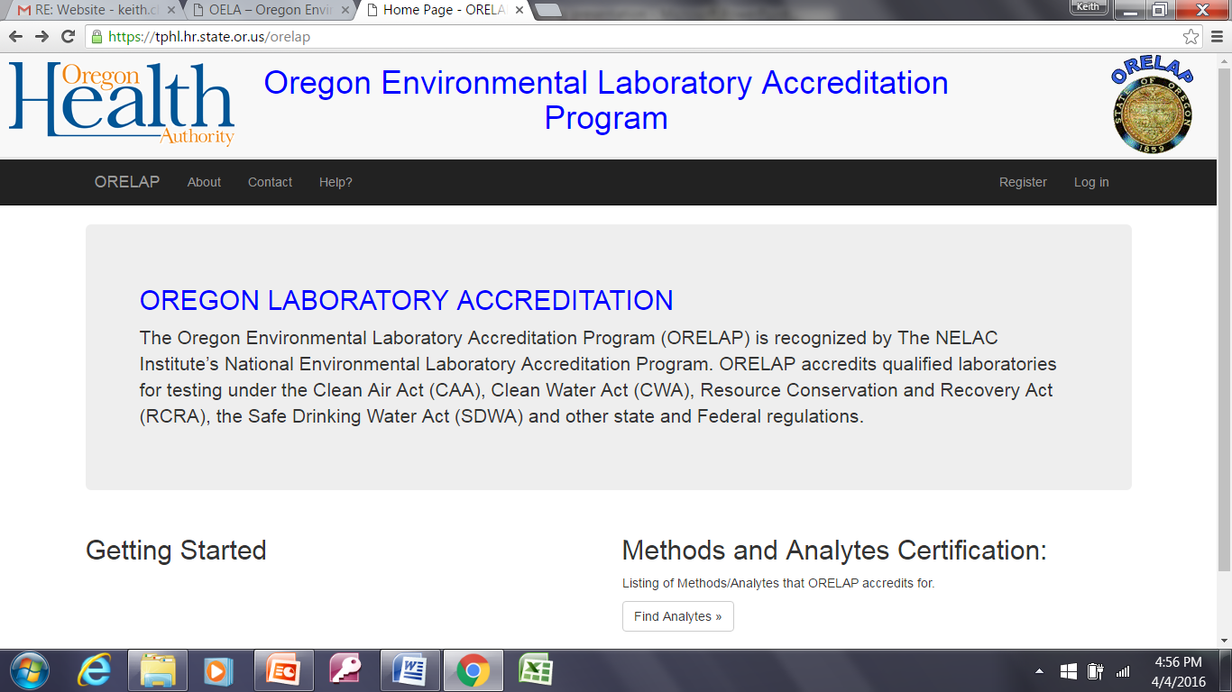

Slide 6
ORELAP
Alia Servin, Program Manager
Lizbeth Garcia, Assessor
Ryan Pangelinan, Assessor
Steve Jetter, Assessor
Notes:
MENTION Q&A PANEL QUESTION FORMS KYLE GROGAN

Slide 7
EXHIBITORS
Agilent Technologies
Astoria-Pacific / Environmental Express
Bio-Rad Laboratories
Cole-Parmer
Environmental Sampling Supply (ESS)
FIAlab Instruments
GE Healthcare
Hach Company
Idexx Laboratories
Industrial Source
Nurnberg Scientific
PerkinElmer, Inc.
Sarstedt, Inc.
Shimadzu Scientific Instruments
Thermo Fisher Scientific

Slide 8
EXHIBITOR PRIZE DRAWING
Our Exhibitors have donated items to fill the prize basket on display in the gallery.
Each attendee will receive a game card with the participating sponsor logos on the game card. Attendees will need to visit ALL exhibitors listed and get their game card stamped at every booth. Once all stamps have been received (in the corresponding boxes), game cards can then be deposited into a drop-box located at the OELA registration booth. Game cards must be turned in by 3:30 pm on Thursday, May 9th in order to be eligible for the prize drawing.
The prize drawing will take place on Thursday, May 9th after the ORELAP Assessor Q&A Panel concludes. Attendees must be present to win.

Slide 9
Overview: Morning
7:30 AM | Registration | OELA BOD Members
8:00 AM | Welcome and Introductions Introduction of Exhibitors OELA Membership Yearly Meeting Reading of OELA Anti-Trust Statement Reading of OELA Code of Ethics Election of Board Members John Neilson Recognition and Birthday | Rory White OELA President
8:30 AM | ORELAP TECHNICAL ADVISORY COMMITTEE (OTAC) OTAC Update | Marsha Farooqui Portland Water Bureau OTAC Chair
8:45 AM | Oregon Laboratory Accreditation Program (ORELAP) Program Update and Procedure for Method Version Updates and PTs | Alia Servin Oregon OHA ORELAP Program Manager
9:30 AM | New Regulations for Lead Testing for Schools in Oregon | Brian Hodges-French and Michael Elliott Oregon Department of Education
10:00 AM | BREAK AND EXHIBITORS
10:30 AM | Generations: The Speed of an Everchanging Workforce | Scott Sadler Creative Conflict Solutions
11:30 AM | BOLI Rules and Impact on Labs | Val Hoyle Oregon Bureau of Labor and Industries
Notes:
Morning Program

Slide 10
Overview: Afternoon
12:00 AM | LUNCH AND EXHIBITORS
1:30 PM | 2016 TNI Standard Implementation and The New EPA MDL Procedure and the New LOD/LOQ TNI Requirement: How They Work Together | Jerry Parr Executive Director The NELAC Institute
2:30 PM | Laboratory Ethics | Gary Ward Ward Associates
3:00 PM | BREAK AND EXHIBITORS
3:30 PM | Q&A Panel with the ORELAP Assessors OELA Moderator Kyle Grogan | Alia Servin Lizbeth Garcia Ryan Pangelinan Steve Jetter
4:00 PM | DRAWING FOR THE EXHIBITOR BASKET
4:00 PM | PICK UP CERTIFICATES from the Registration Table
4:00 PM | VISIT WITH EXHIBITORS
5:00 PM | CLOSE
Notes:
Morning Program

Slide 11
Certificate of Attendance Available At Registration Table After 4:00
Notes:
There will be a sign up list for these certificates of attendance.

Slide 12
OELA Anti-Trust Statement
Oregon Environmental Laboratory association STATEMENT ON COMPLIANCE WITH ANTI-TRUST LAWS
Legal Limitations on Discussions at OELA Meetings
It is the desire of OELA as a trade association and its members to operate and conduct business meetings in a manner that reflects both the spirit and the intent of Anti-Trust laws.
A free exchange of ideas and views on matters of mutual interest to representatives of the environmental laboratory industry including laboratories, regulatory authorities, laboratory clients and laboratory suppliers is essential to the successful operation of OELA.
It is not the purpose of this document to discourage the exploration of any matters of legitimate concern to meeting participants. Nevertheless, ignoring Anti-Trust ground rules, either through ignorance or otherwise, may create hazards that OELA members cannot afford.
The directors and members of OELA are reminded that they are required to comply with the spirit and specific requirements of the Anti-Trust laws on all activities within the scope of and related to official functions of the organization.
The general requirements of the Anti-Trust laws prohibit agreement to restrict trade between competitors. Among the specific prohibitions are included the following items:
“…. discussing or agreeing to fix or regulate current or future prices of services, price lists or the conditions of terms of sale.”
“… discussing or agreeing to any procedures or process for coordinating price changes.”
“… discussing or agreeing to establish geographical trading areas, allocate markets or clients, or classify certain clients as being entitled to preferential treatment.”
“… discussing or agreeing to boycott any party or deny any party access to markets, services or publicly available information.”
“… participating in any plan designed to induce any vendor or laboratory to sell or refrain from selling or discriminate in favor or against any particular customer/client or class of customer/clients.”

Slide 13
OELA Code of Ethics
Oregon Environmental Laboratory Association
Code of Ethics
All members of the Oregon Environmental Laboratory Association are committed to establishing and maintaining high standards of ethics and quality in our industry. Individual members and member laboratories demonstrate their continuing commitment to ethics and quality by agreeing to:
Build on existing Association relationships with state and local agencies. Promote open and timely communication between government regulators and the regulated community.
Increase client knowledge. Educate clients regarding technical issues as well as their legal and ethical rights and responsibilities.
Train employees appropriately. Ensure competency before allowing employees to perform sample preparation, chemical analysis or data generation.
Encourage all members of our industry to obey all pertinent federal, state and local laws and regulations. Lead by example.
Maintain laboratory facilities, equipment and instrumentation adequately to ensure the accuracy and precision of measurements.
Elevate the status of all environmental laboratories, their employees and the value of the services they perform.
Willingly participate in critical review through ORELAP, EPA and third party Performance Evaluation programs, agency audits and client challenges of data.
Accept work only when there exists a reasonable expectation that the client will gain something of value. Satisfy all commitments to quality, timeliness and other project objectives. Provide services in a confidential, honest and forthright manner.
To deal honestly and fairly in all business and financial matters with employees, clients and the public.
Legally and ethically manage laboratory waste. Make responsible decisions regarding disposal, recycling, reuse and minimization.
Treat clients, employees and the environment with respect. Operate facilities in a manner that protects the environment and the health and safety of employees and the public.

Slide 14
OELA Board Election
Rory White, Consultant
Kim Ramsey, Neilson Research Corporation
Sherri Miyazaki, Box R Waterlab
Jennifer Shackelford, City of Portland Water Pollution Control Laboratory
Gary Ward, Ward Consultants
Michelle Miranda, City of Eugene Public Works
Notes:
Persons residing or employed in the State of Oregon who are engaged in the operation of or who are employees of an environmental laboratory, or who are engaged in providing support, supplies or services to environmental Labs.

