Slide 1

OELA / ORELAP Annual Environmental
Laboratory Conference
ORELAP UPDATE
Alia D. Servin, Ph.D.
ORELAP Program Manager
May 9, 2019

Slide 2
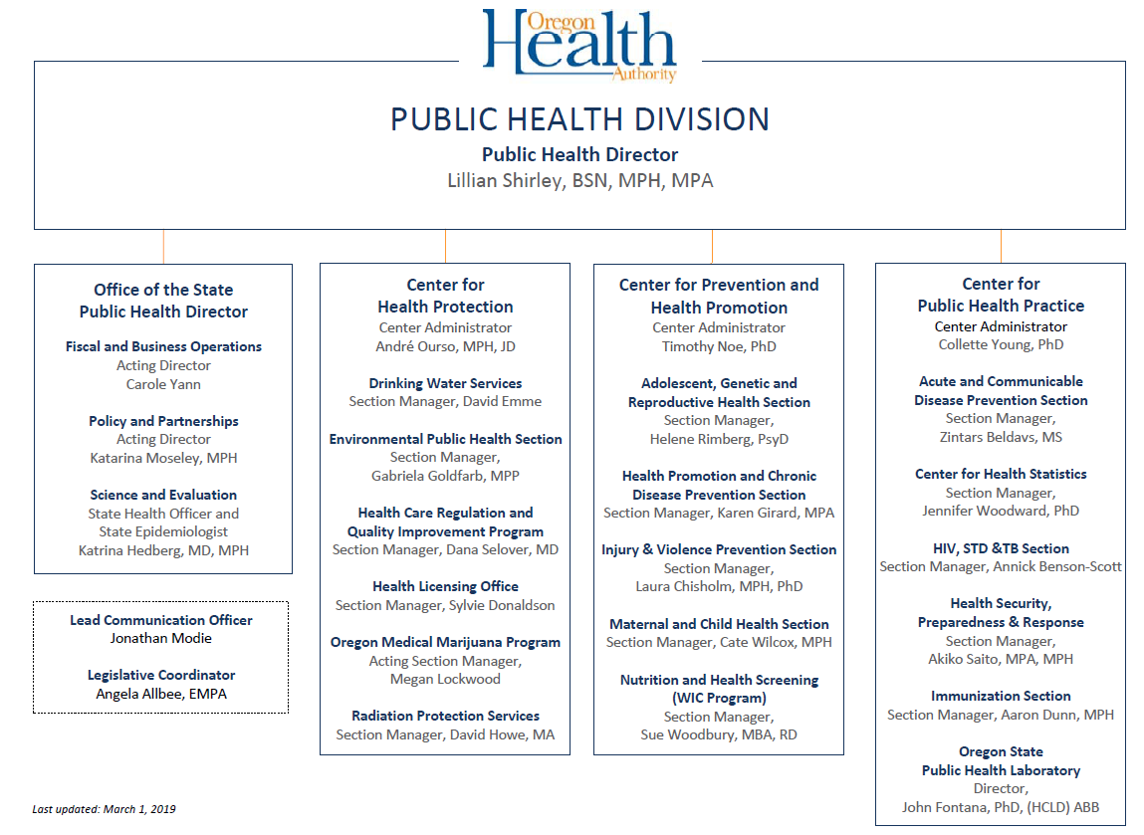

Slide 3

General Overview of the Laboratory Compliance Section ORELAP
ORELAP accredits over 150 Environmental Laboratories:
66 in-state laboratories
    22 Drinking water laboratories that accept public samples
    11 Drinking water laboratories that do not accept public samples
    22 Cannabis laboratories
    11 Environmental laboratories
63 out of state laboratories
    37 Drinking water laboratories that accept public samples
    5 Drinking water laboratories that do not accept public samples
    21 Environmental laboratories
23 secondary out of state laboratories

Slide 4
Mandated Laboratories to be ORELAP accredited
  ORELAP accredits qualified laboratories for testing under the Clean Air Act (CAA), Clean Water Act (CWA), Resource Conservation, Recovery Act (RCRA) and the Safe Drinking Water Act (SDWA).
  ORELAP accredits Cannabis testing laboratories under ORS 475B.550 to 475B.590.
  Drinking water and cannabis testing laboratories are mandated to be ORELAP accredited.
  ORELAP goal is to have all assessors to be certified for microbiology and chemistry (organic/inorganic) as EPA DW CO.

Slide 5
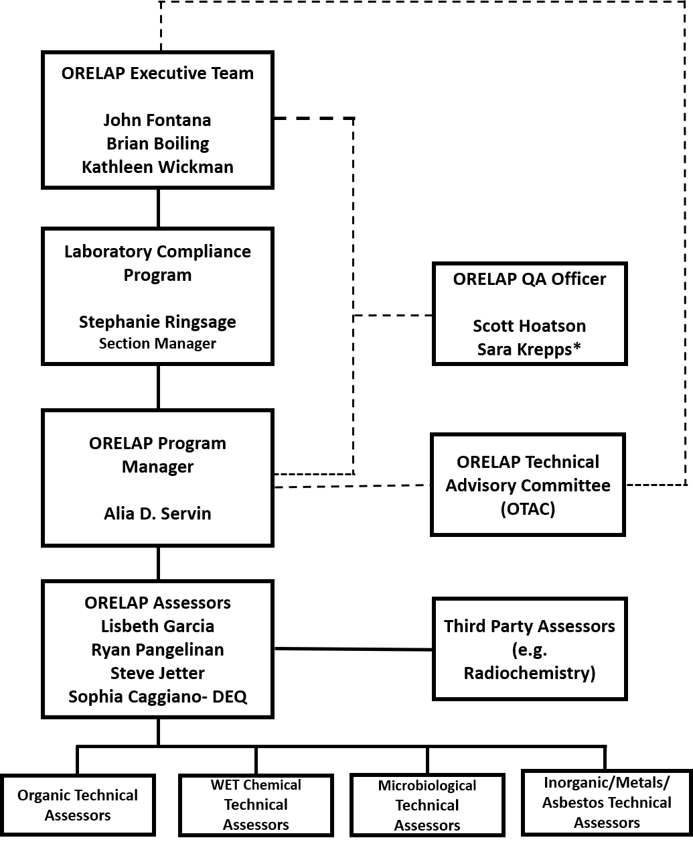

Slide 6
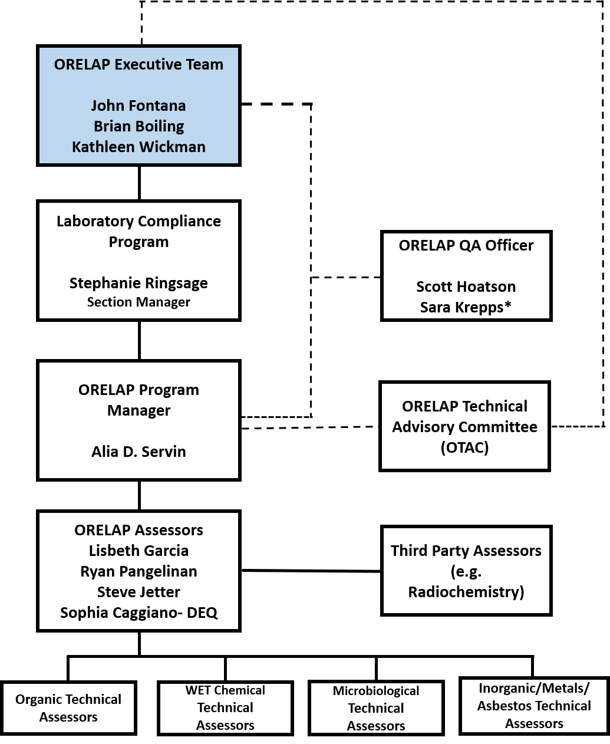
ORELAP Organizational Chart
  Personnel Consist of the following:
  Executive Team:
  Dr. John Fontana, OSPHL Lab Director
  Brian Boiling, DEQ Administrator
  Kathleen Wickman, Dept. of Agriculture
  The Executive team has overall responsibility for managing ORELAP and has final authority over the program.

Slide 7
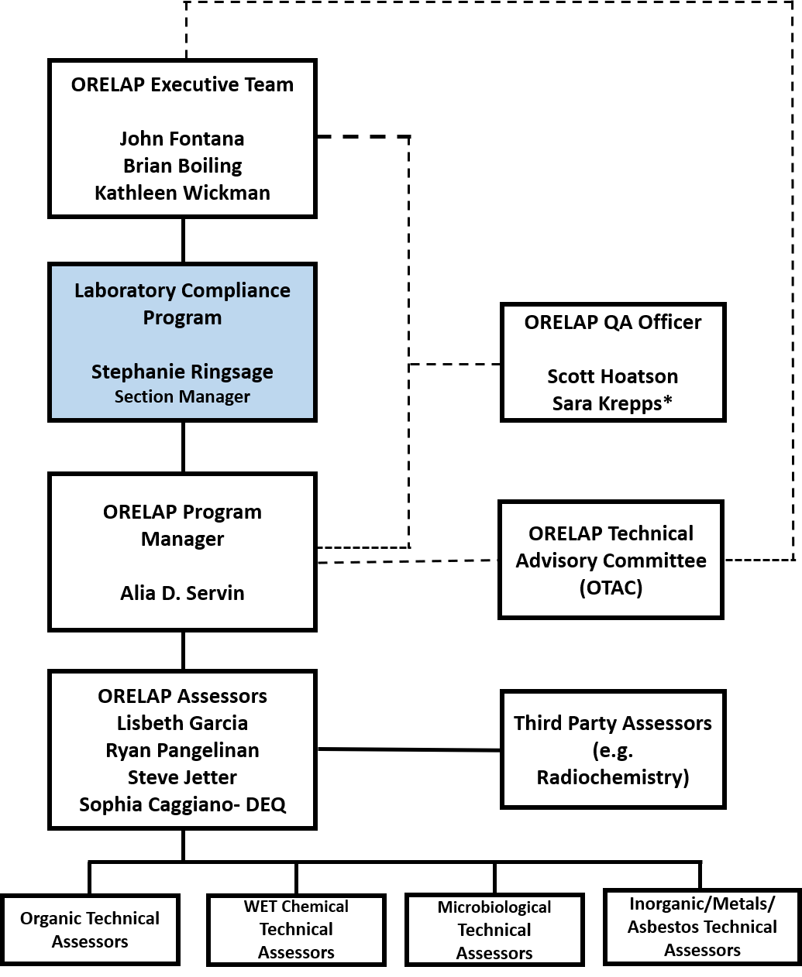
ORELAP Organizational Chart
  Stephanie Ringsage, B.S. MT (ASCP)
  Section Manager – Clinical and Environmental
    Stephanie Ringsage
    Laboratory compliance Manager
Program Support
(Administrative Spec 2)
CLIA
HST SOA
ORELAP

Slide 8
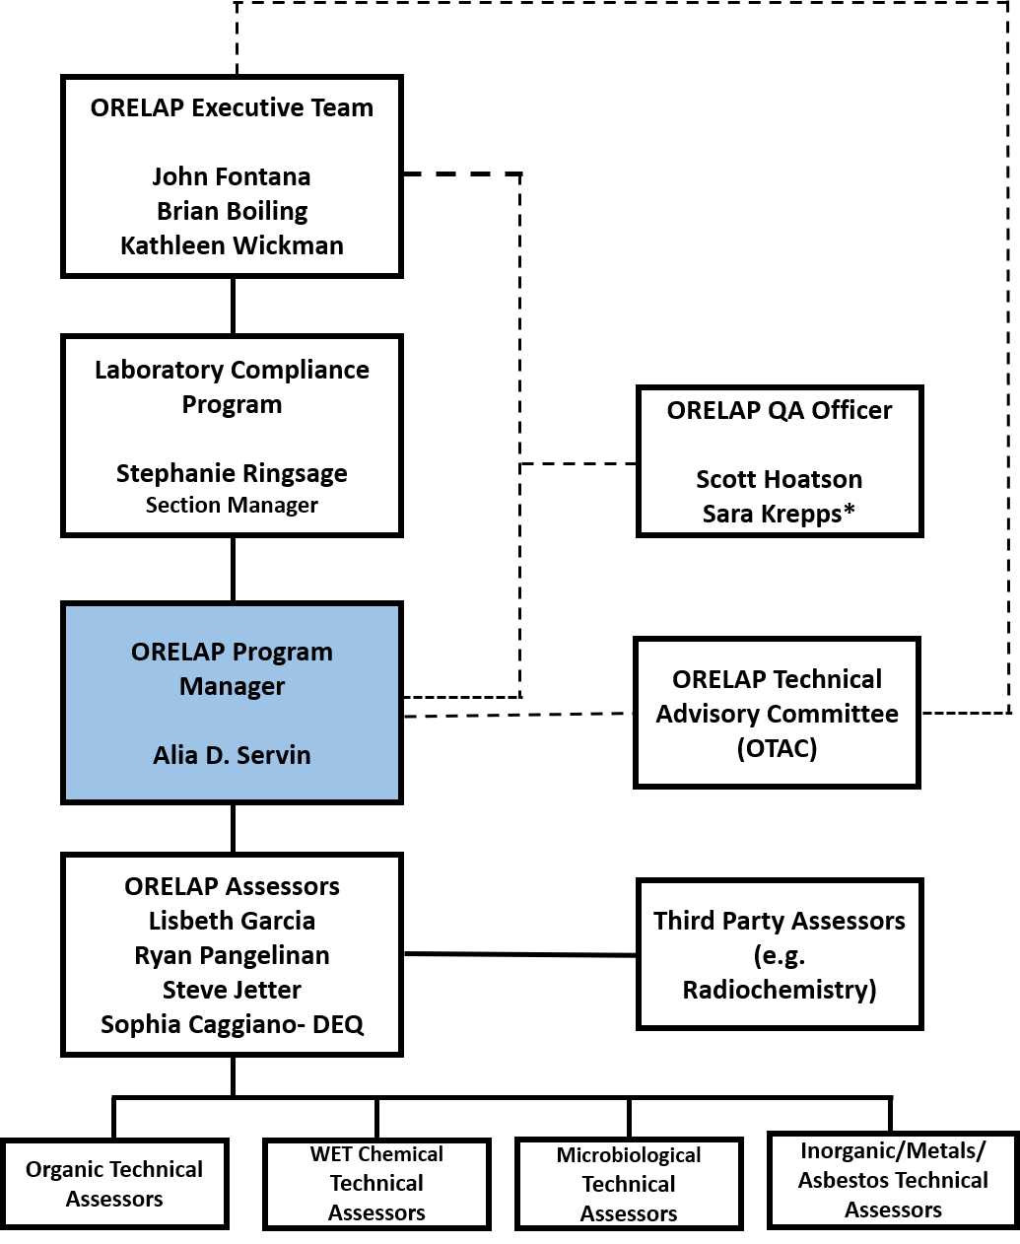
ORELAP Assessors
Alia D Servin, Ph.D.
ORELAP Program Manager
Ph.D. in Analytical Chemistry at University of Texas at El Paso
Former Post-doctoral Research Scientist at the Connecticut Agricultural Experiment Station
Joined ORELAP on March 2017
Training:
TNI training
    Basic Assessor Training- TNI Standard 2009
    Radiochemistry*
    WETT*
    * In training
EPA Certification for Drinking Water
    Organic Chemistry
    Inorganic Chemistry
    Cryptosporidium

Slide 9
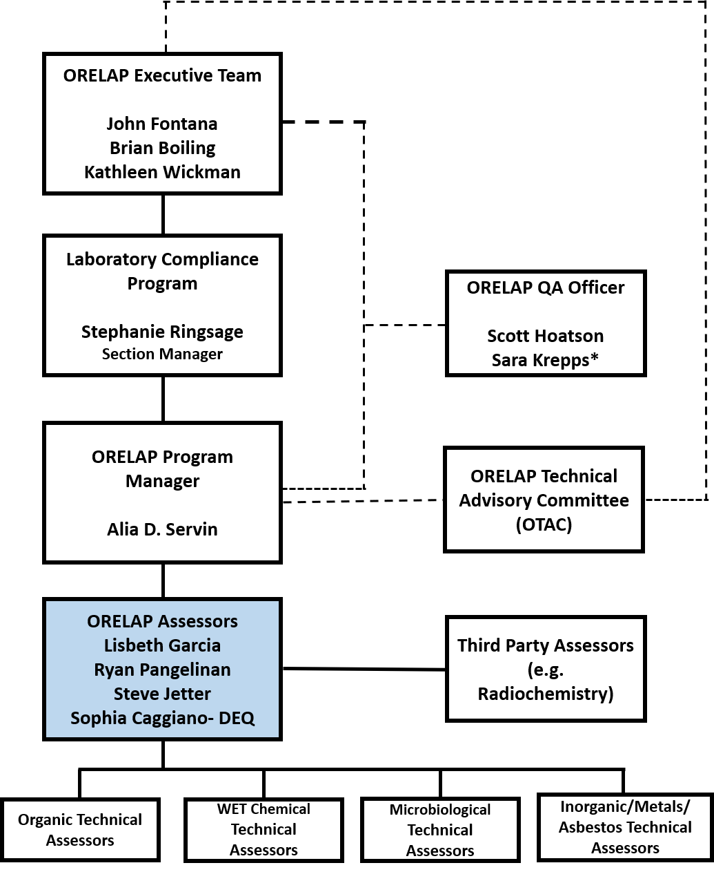
ORELAP Assessors
Lizbeth Garcia, MS
ORELAP Lead Assessor
Master of Science in Analytical Chemistry at New Mexico State University
Former DEQ chemist
Joined ORELAP on October 2015
Training:
TNI training
    Basic Assessor Training- TNI Standard 2009
    Radiochemistry*
    WETT*
    * In training
EPA Certification for Drinking Water
    Organic Chemistry
    Inorganic Chemistry
    Microbiology
    Cryptosporidium

Slide 10
ORELAP Update
Ryan Pangelinan, BS
ORELAP Assessor
Bachelors of Science in Biology/Chemistry at the Eastern Oregon University
Former DEQ chemist
Joined ORELAP on March 2017
Training:
TNI training
    Basic Assessor Training- TNI Standard 2009
    Radiochemistry*
    WETT*
    * In training
EPA Certification for Drinking Water
    Organic Chemistry
    Inorganic Chemistry

Slide 11
ORELAP Assessors
Steve Jetter, BA
ORELAP Assessor
Bachelors of Arts in Biology/Chemistry at Lewis & Clark College
Former DEQ chemist
Joined ORELAP on October 2018
Training:
TNI training
    Basic Assessor Training- TNI Standard 2009
    WETT*
    * In training
EPA Certification for Drinking Water
    Organic Chemistry* (July 2019)

Slide 12
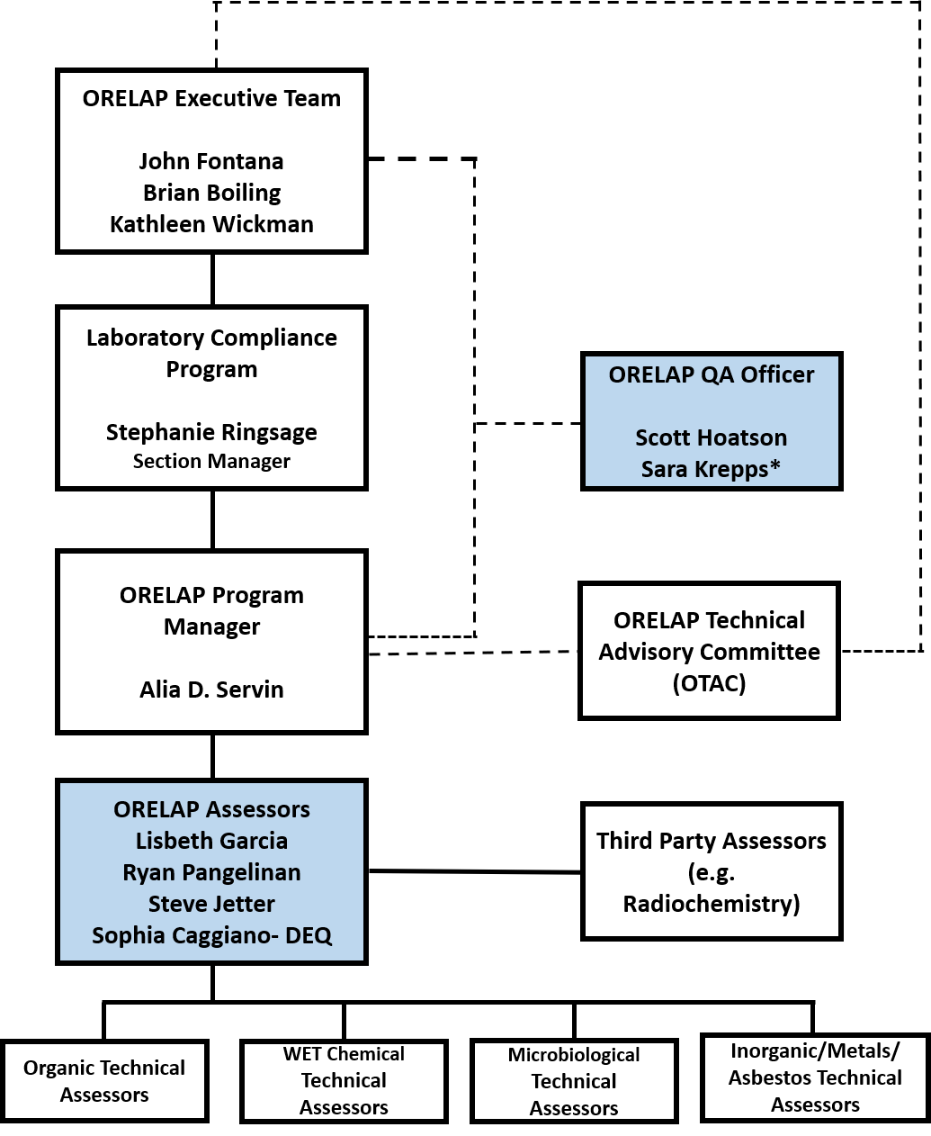
Interagency Agreement with DEQ
  DEQ staff:
  Scott Hoatson, DEQ QA Officer/ORELAP QA Officer
  Sara Krepps, DEQ QA Officer/ORELAP QA Officer
  Sophia Caggiano, DEQ/ORELAP assessor
  The ORELAP Quality Assurance Officer (QAO) is responsible for monitoring ORELAP operations to help ensure that the program is adhering to its adopted policies and procedures.
  Scott has been a resource of support to the ORELAP program, he will retire at the end of May 2019
  Sara Krepps will continue to provide technical guidance to ORELAP
  Sophia had earned her TNI basic training certification March 2017
Training:
TNI
    Basic Assessor Training- TNI Standard 2009
EPA Certification for Drinking Water
    Organic Chemistry
    Inorganic Chemistry

Slide 13
Average number of days from assessment to initial ORELAP report
  Review 2018:
  Jan to Dec 2018: ORELAP assessors conducted 53 on-site assessments.
  Average number of days from assessment to initial ORELAP report 29 days.
  AB’s- 30 day requirement for final report according to the TNI Standard: V2M3-ISO-2009: 6.12.2.

Slide 14
ORELAP Update
  Secretary of State audit, update of ORELAP responses (June 2019).
    PT samples in cannabis matrix now available for solvents, microbiology analytes and metals.
  ORELAP can accredit Drinking Water labs for cyanotoxin methods.
    OAR 333-061-0550

Slide 15
ORELAP Goals
  To provide all resources and training opportunities to ensure each assessor is cross trained in all fields of accreditation.
  To be proactive rather than reactive to the constant challenges of regulating laboratories. We strive to assure the quality testing in environmental laboratories keep Oregonians healthy.
  Our program has an impact on not just the laboratories seeking ORELAP accreditation, but has a direct impact on other agencies that are within and outside the Public Health Division (PHD) centers.

Slide 16
Goals to develop program relationships
  Working closely with OMMP, OLCC and ODA regarding cannabis issues.
  Working with Drinking Water program and assuring ORELAP accredited labs are submitting accurate, timely complete results for drinking water facilities.
  Seeking expertise and guidance from DEQ/ORELAP QA officer and from the Executive Team representing OHA, DEQ and ODA.

Slide 17
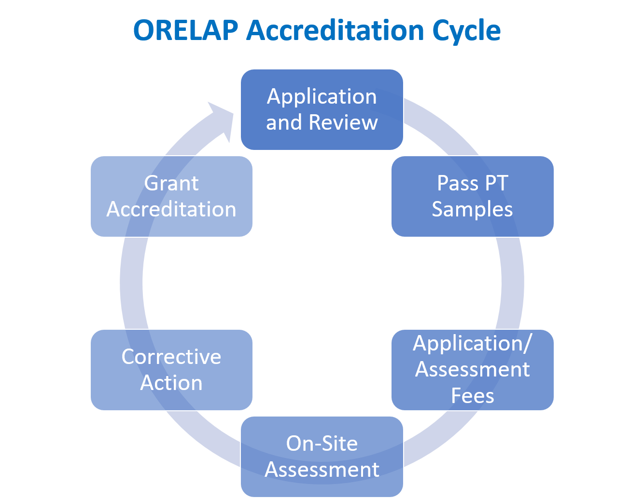
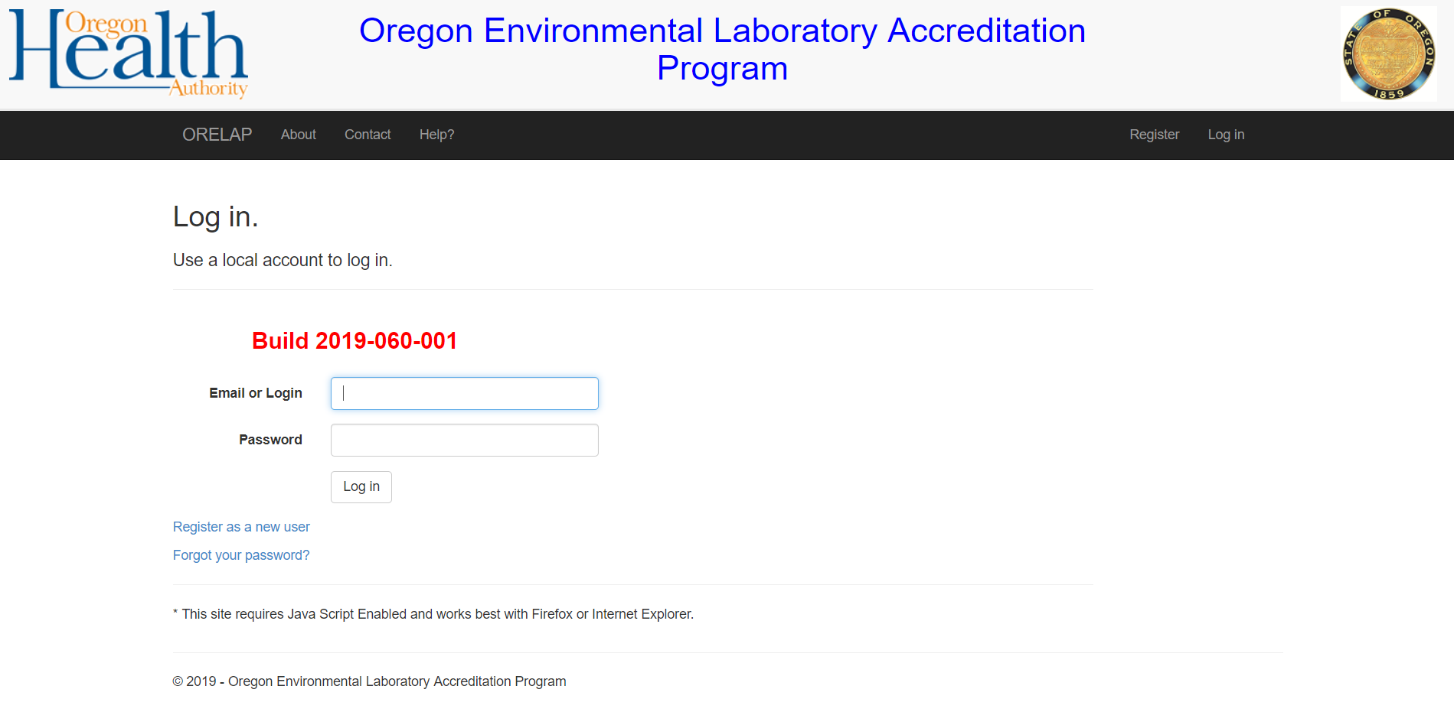
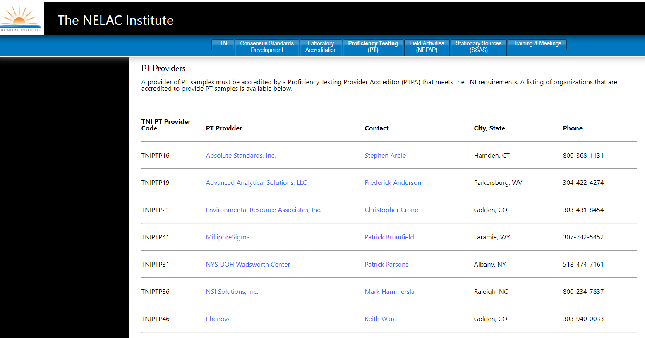
ORELAP Accreditation Cycle

Slide 18
ORELAP Proficiency Testing Reports
During the OTAC meeting in April 2019 several questions were brought to ORELAP regarding PTs.
PTs – how are they being handled?
  PT: email address?
  How is data being uploaded into ODIE?
  When is PT data reviewed?
  Do you notify related agencies if certification is revoked or suspended? (i.e. OHA, DEQ?)

Slide 19
-Background-
ORELAP TNI Audit 2015
Finding: ORELAP is not following the Standard in regards to considering a nonspecific PT match to be considered a failure.
Citation: V2M2, 7.3 (c)-
Recommended Corrective Action: If the laboratory reports an incorrect method, this PT results should be evaluated as not acceptable since it does not match the field of accreditation for which the laboratory is accredited or seeking to become accredited.
ORELAP Response: ORELAP has changed its PT evaluation program to evaluate a PT with method errors in the field of accreditation as unacceptable.

Slide 20
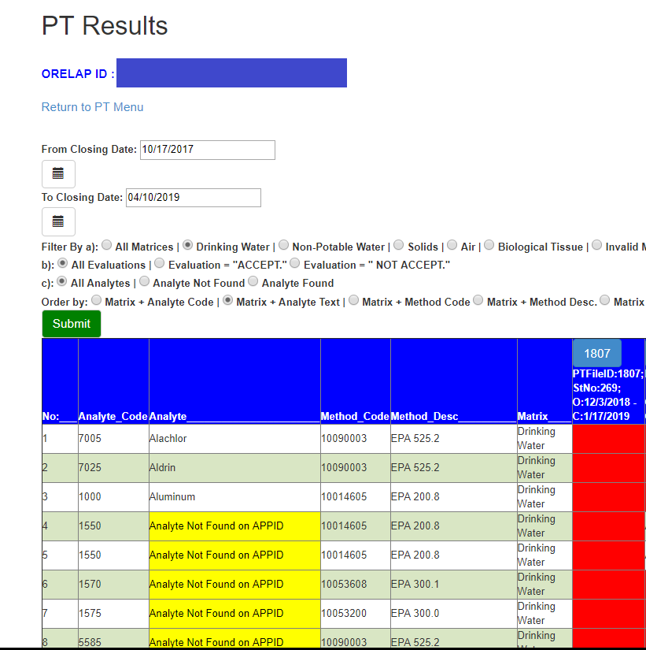
Proficiency Testing Reports that result in a non-specific match
Citation: V2M2, 7.3 (c)-
“The Primary AB shall consider the analytical result for a FoPT not acceptable when:
c) the laboratory makes any reporting error or omission that results in a non-specific match between the analytical result for the FoPT and any criterion that identifies the laboratory or the field of accreditation for which the PT sample was analyzed for the purpose of initial or continued accreditation;”

Slide 21
ORELAP Proficiency Testing Reports
  1. PT reports are to be sent via email to ORELAP PT outlook mailbox direct from the PT provider:
        ORELAP.PT@dhsoha.state.or.us
  2. PT providers must email two files ( PDF and Excel raw data documents)

Slide 22
ORELAP Proficiency Testing Reports
  3. ORELAP uploads files (PDF and Excel documents) in ODIE system (only available for ORELAP staff).
  4. PT results are to be evaluated for conformance to the TNI standard to determine the accreditation status of a laboratory within 60 days of the receipt of the final report from the PT provider.
  5. ORELAP notifies related agencies if the certification has been revoked or suspended.

Slide 23
ORELAP
How to verify your Fields Of Accreditation
  Check your current FOA (sent by email).
  During the renewal application process, verify the codes and references for your methods and analytes.
  3. Download the “Fields of Accreditation Summary” from ODIE system.
  TNI LAMS.
  ORELAP website - OR Drinking Water and Cannabis Labs.

Slide 24
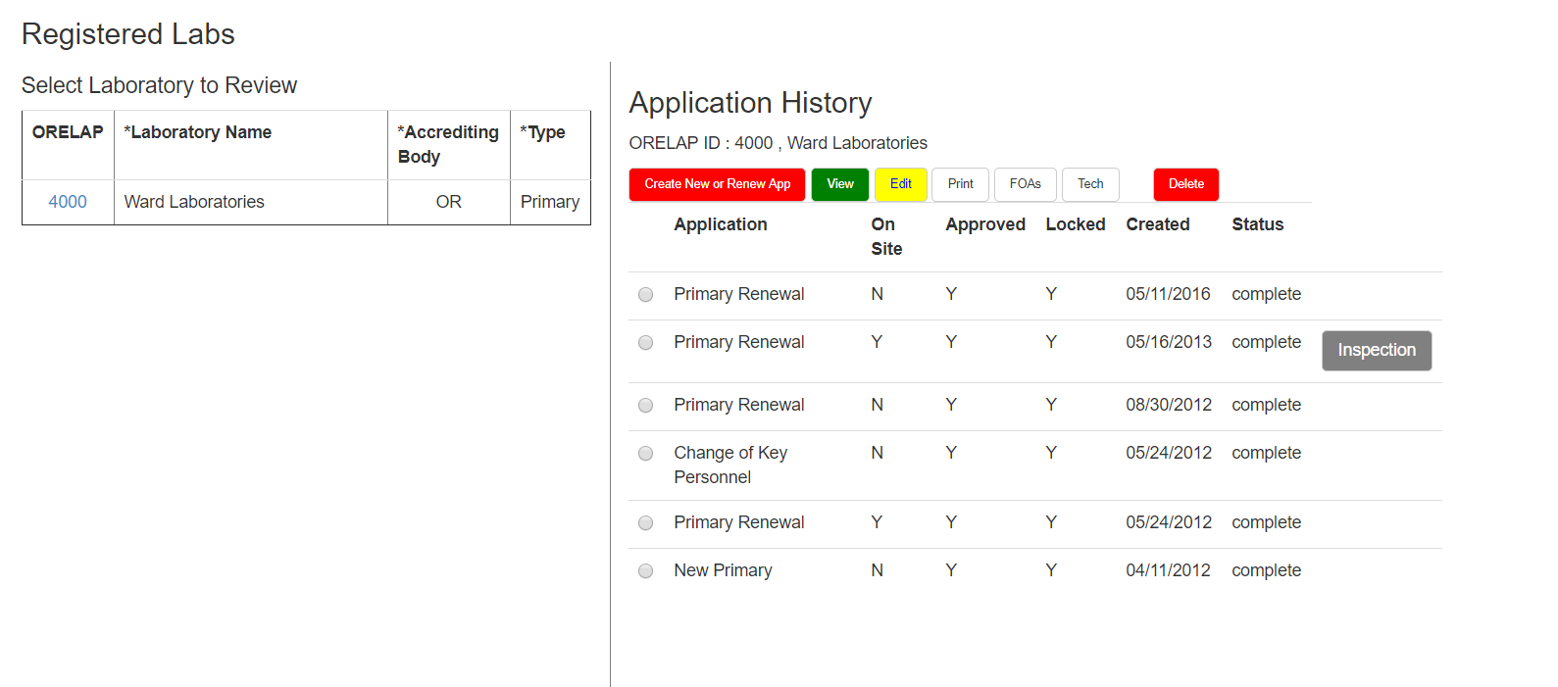
ORELAP Renewal Application
During the renewal application process the laboratory must verify that the method in the application is the intended one.
4.2.1 “To maintain accreditation the laboratory shall:
b) Maintain a history of at least two (2) successful performances out of the most recent three (3) attempts; for each accreditation FoPT; and…”

Slide 25
ORELAP Application

Slide 26
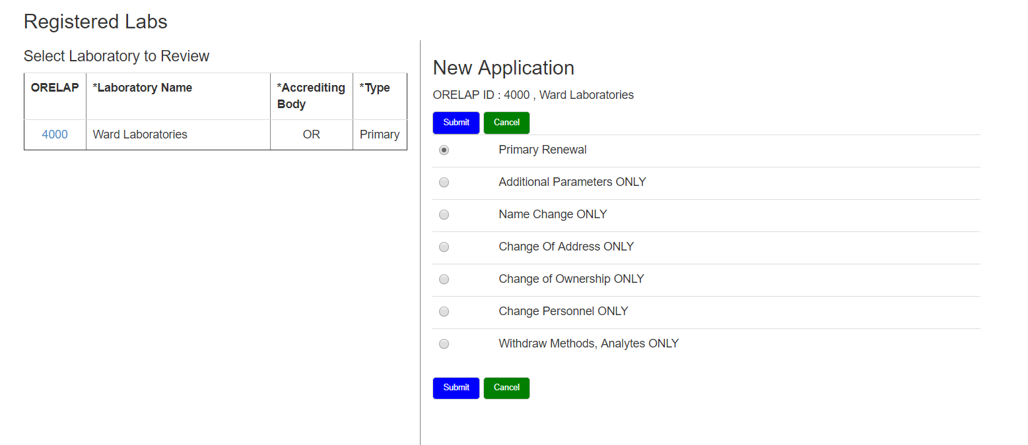
ORELAP Application

Slide 27
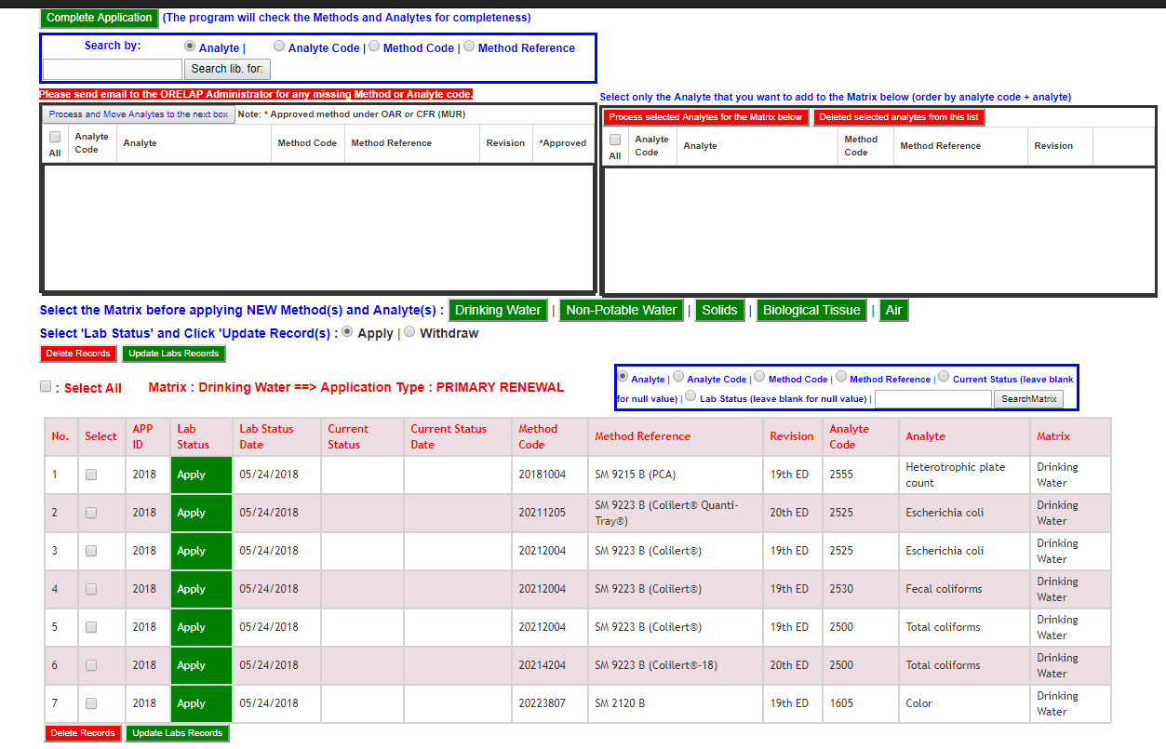

Slide 28
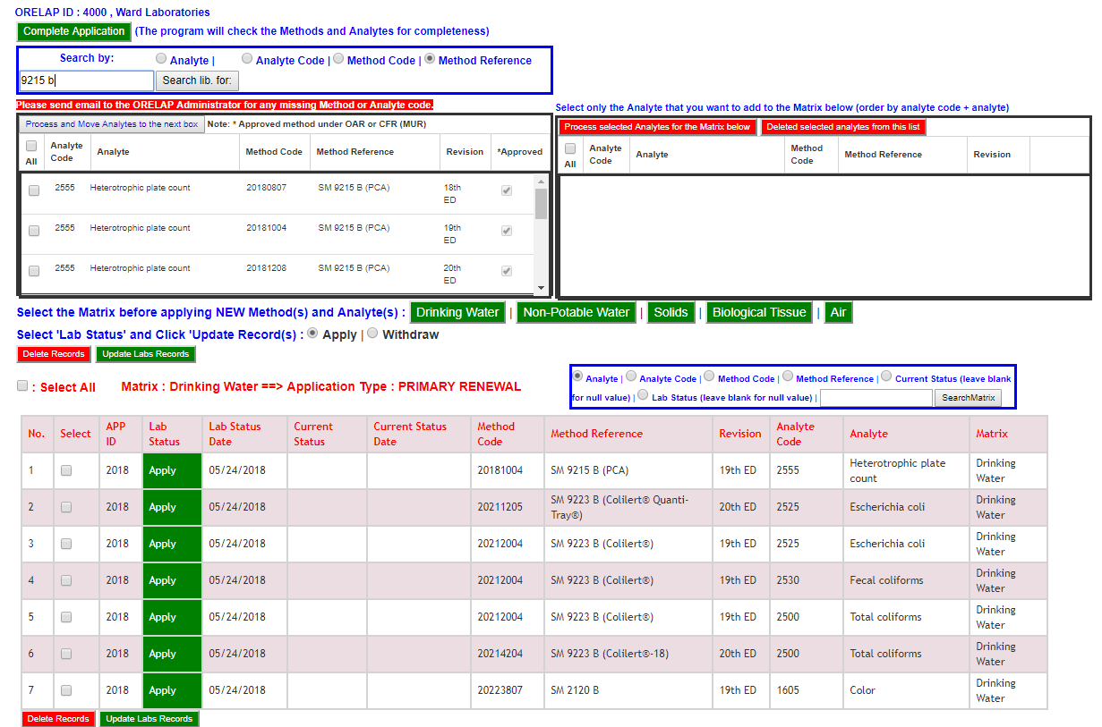

Slide 29
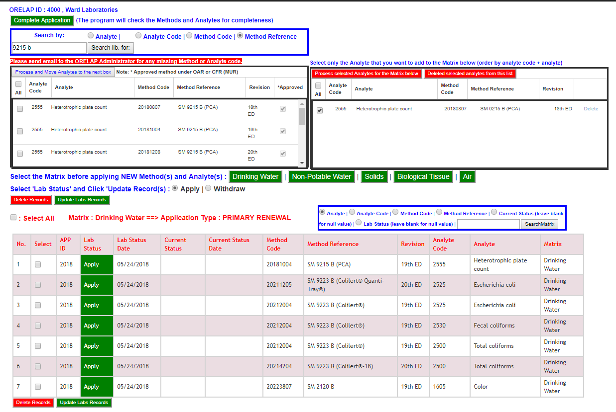

Slide 30
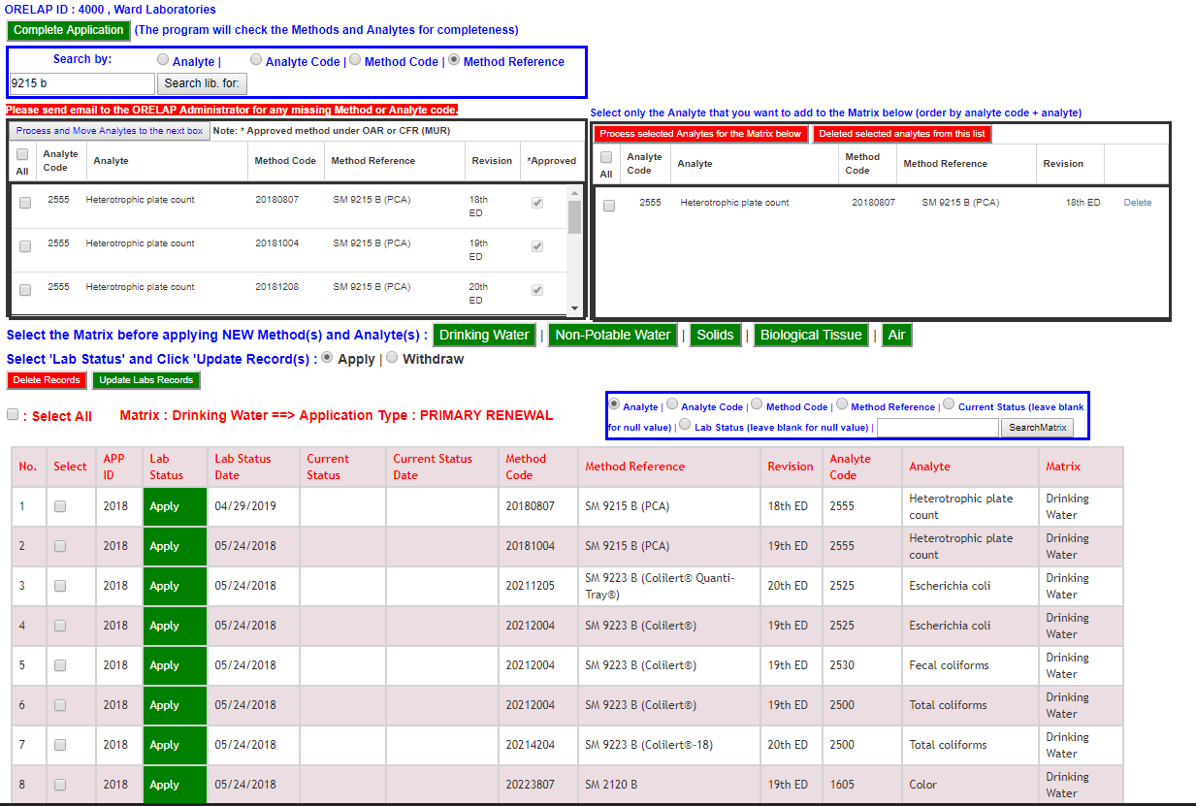

Slide 31
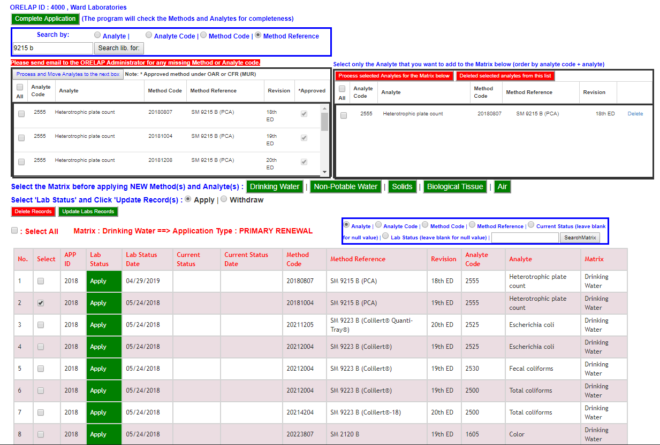

Slide 32
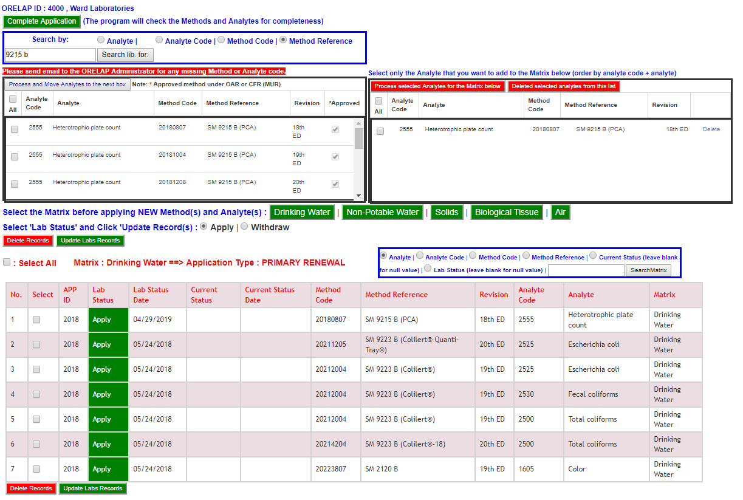

Slide 33
ORELAP
How to verify your Fields Of Accreditation
  Check your current FOA (sent by email).
  During the renewal application process, verify the codes and references for your methods and analytes.
  3. Download the “Fields of Accreditation Summary” from ODIE system.
  TNI LAMS.
  ORELAP website - OR Drinking Water and Cannabis Labs.

Slide 34
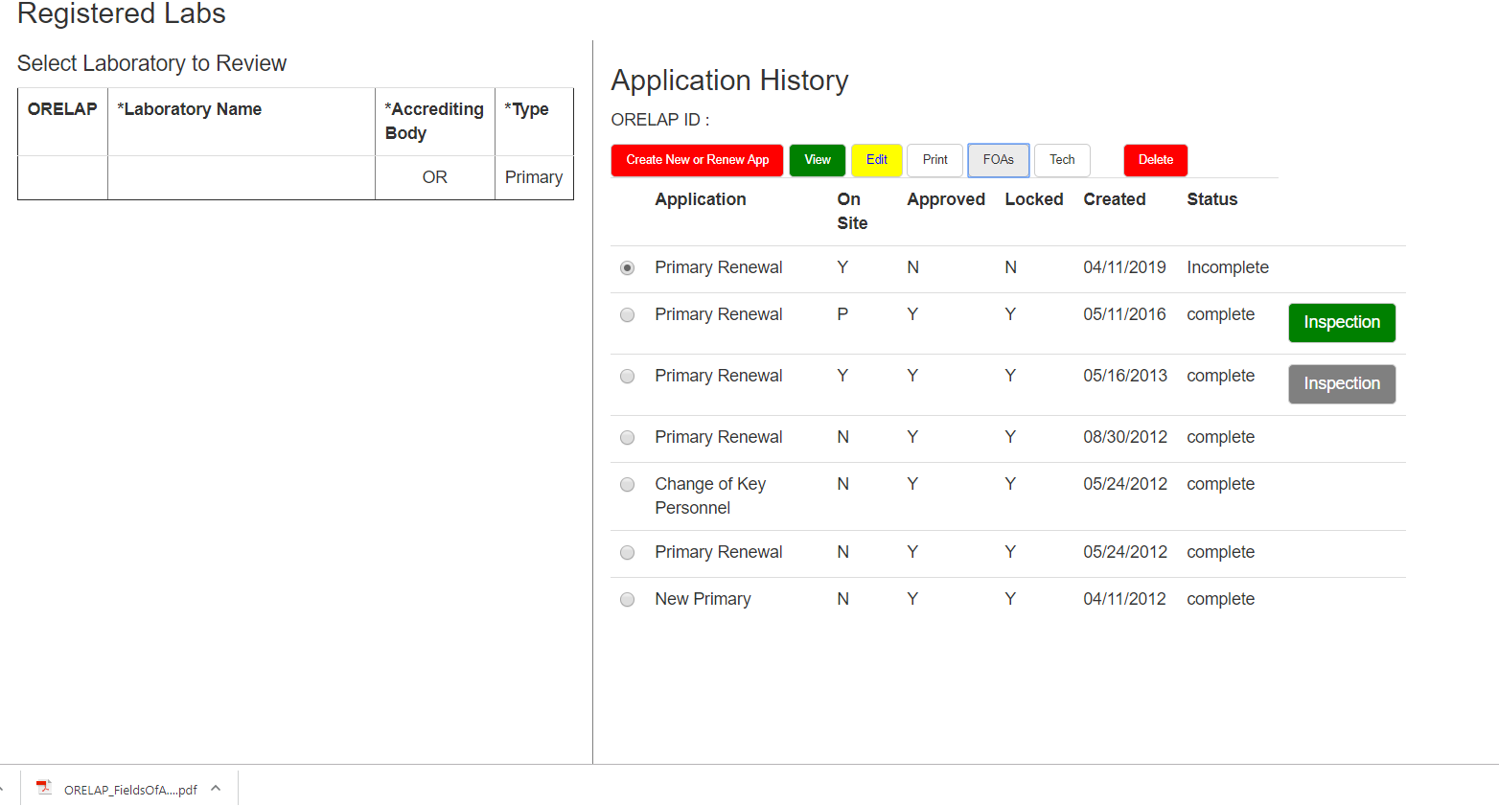

Slide 35
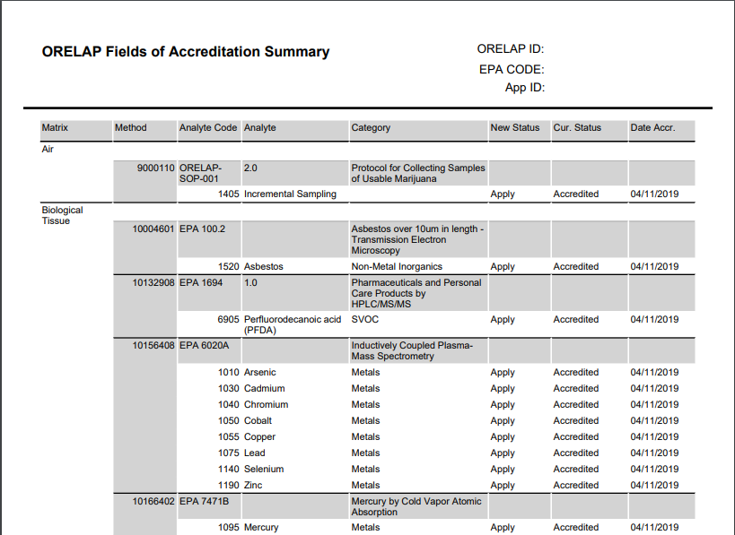
ORELAP Fields of Accreditation Summary

Slide 36
ORELAP
How to verify your Fields Of Accreditation
  Check your current FOA (sent by email).
  During the renewal application process, verify the codes and references for your methods and analytes.
  3. Download the “Fields of Accreditation Summary” from ODIE system.
  TNI LAMS.
  ORELAP website - OR Drinking Water and Cannabis Labs.

Slide 37
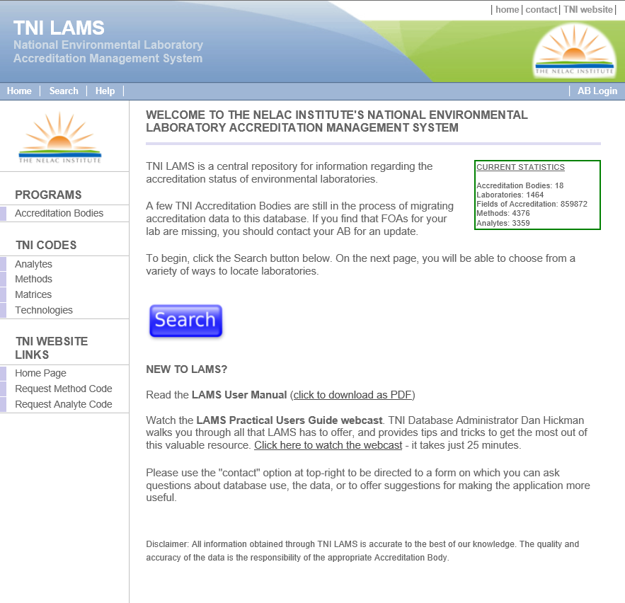
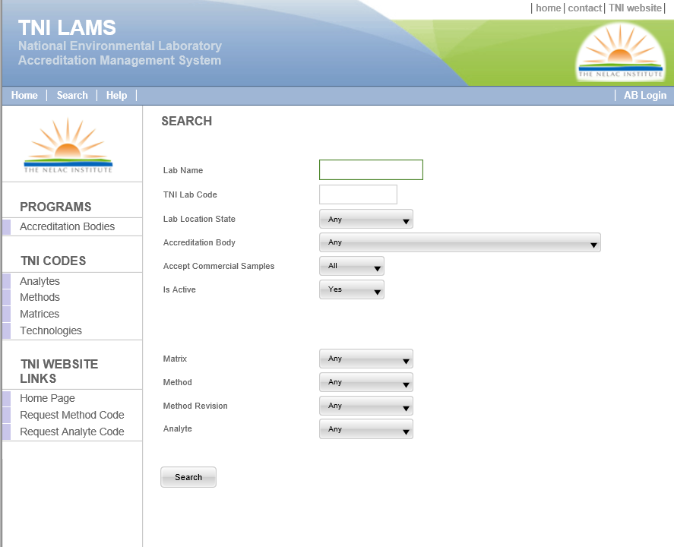
Fields of Accreditation- TNI LAMS

Slide 38
ORELAP
How to verify your Fields Of Accreditation
  Check your current FOA (sent by email).
  During the renewal application process, verify the codes and references for your methods and analytes.
  3. Download the “Fields of Accreditation Summary” from ODIE system.
  TNI LAMS.
  ORELAP website - OR Drinking Water and Cannabis Labs.

Slide 39
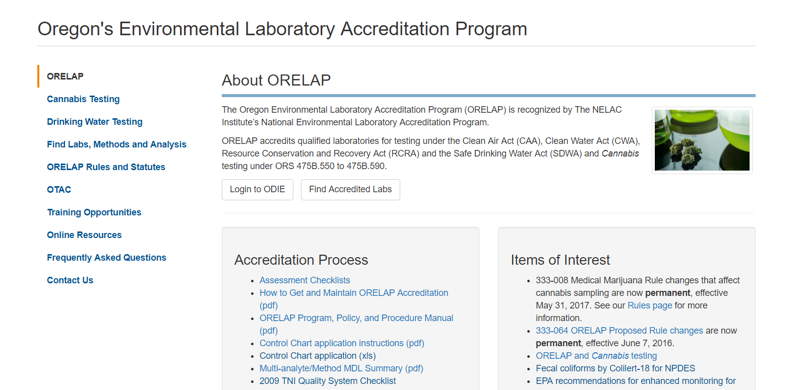
ORELAP Website-
Oregon Drinking Water and Cannabis Labs

Slide 40
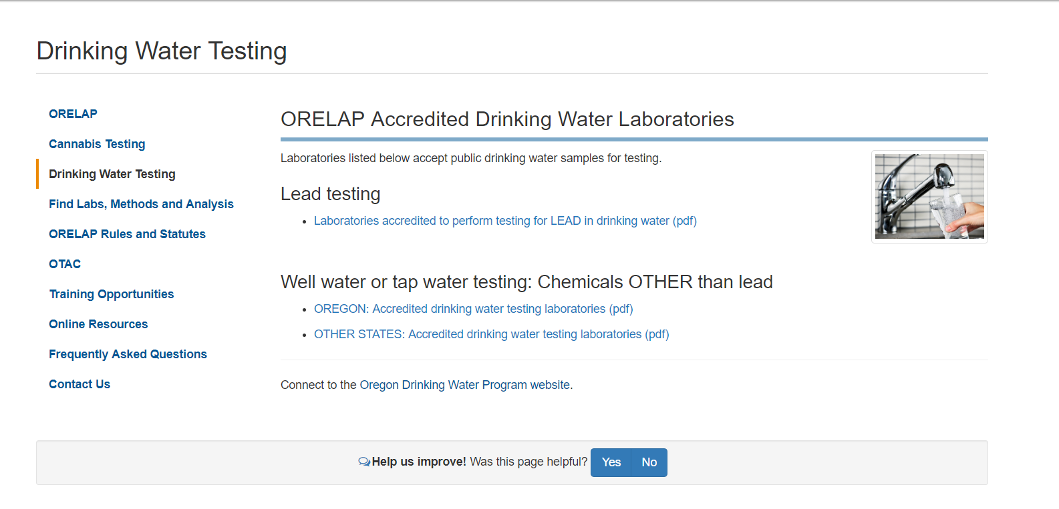
ORELAP Website-
Oregon Drinking Water and Cannabis Labs

Slide 41
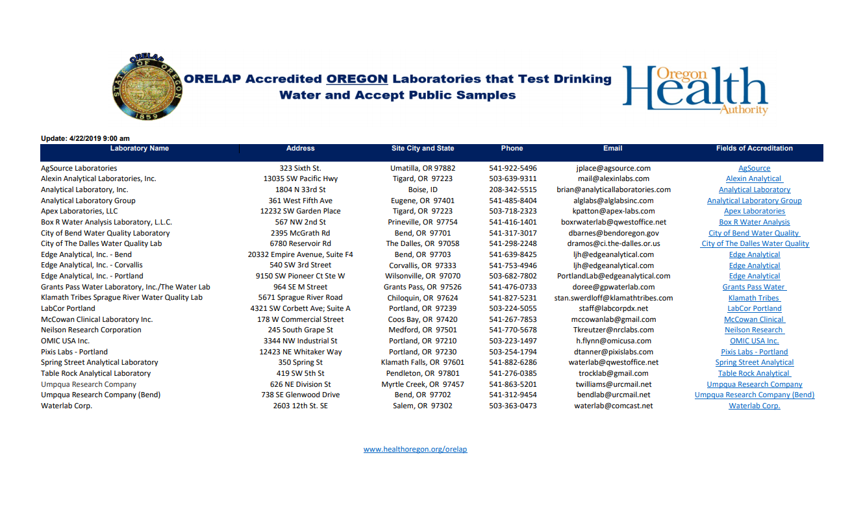
ORELAP Website-
Oregon Drinking Water and Cannabis Labs

Slide 42
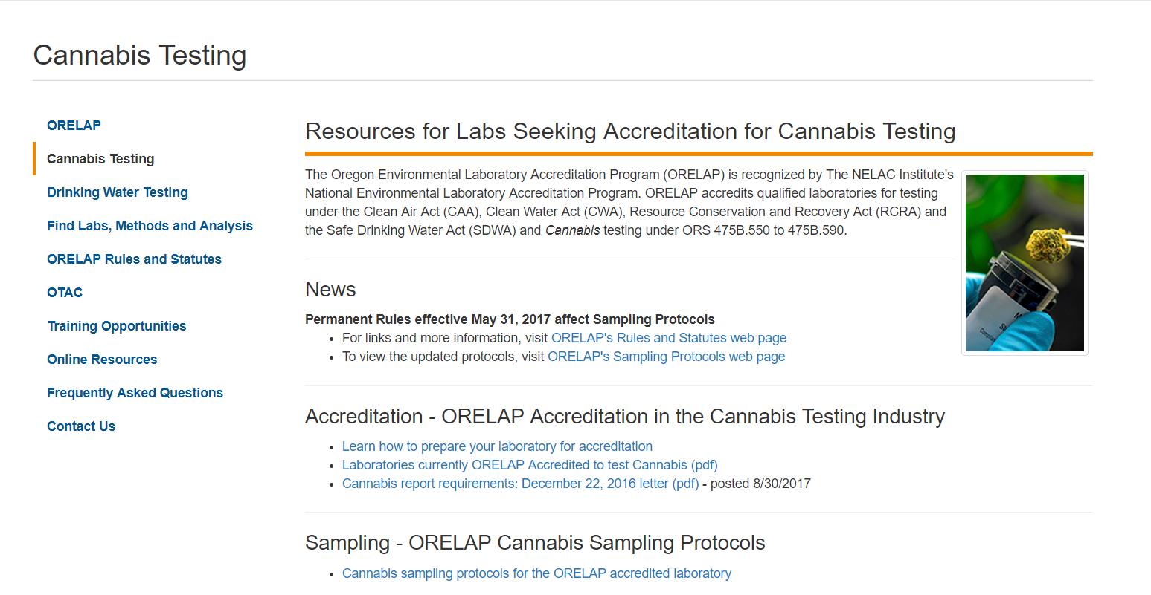
ORELAP Website-
Oregon Drinking Water and Cannabis Labs

Slide 43
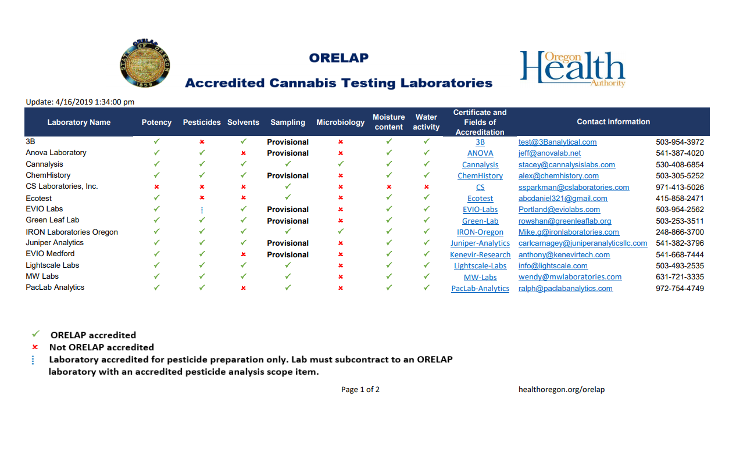
ORELAP Website-
Oregon Drinking Water and Cannabis Labs

Slide 44
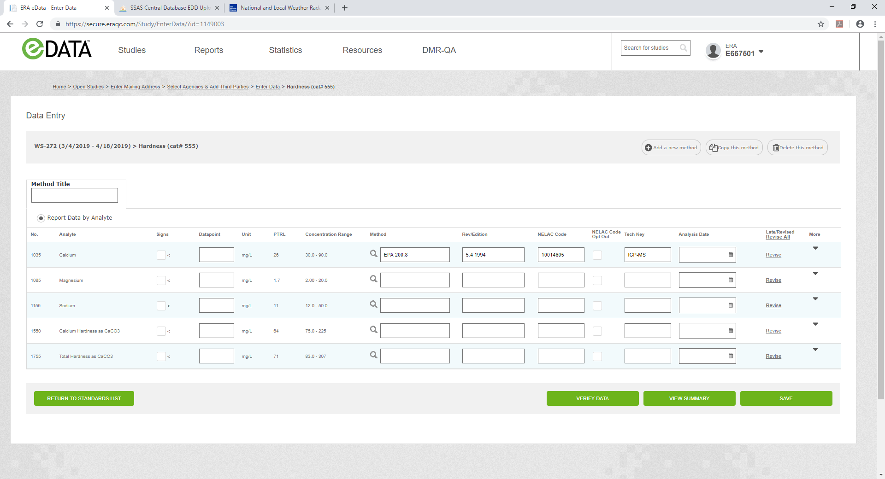
Proficiency Testing Reports
Image courtesy of ERA

Slide 45

Image courtesy of ERA

Slide 46

Image courtesy of ERA

Slide 47
ORELAP Update
  1. ORELAP will mail a letter with more information of this requirement.
  2. Laboratories that have errors (i.e., different method code) in their application will be allowed to modify the application in ODIE.
  3. Laboratories that have their application correct, have successfully performed PTs, but have not been referencing the exact method must correct this by the next PT enrollment (6 months).

Slide 48
Contact ORELAP
Liz Garcia
Lizbeth.garcia@dhsoha.state.or.us 503-693-4115
Ryan Pangelinan
Ryan.Pangelinan@dhsoha.state.or.us 503-693-4129
Steve Jetter
Steve.jetter@dhsoha.state.or.us 503-693-4130
Alia D. Servin
Alia.d.servin@state.or.us 503-693-4122
Stephanie Ringsage
Stephanie.b.ringsage@state.or.us 503-693-4126

