Slide 1
OELA/ORELAP Environmental Laboratory Conference May 24th, 2017

Slide 2
Welcome Oregon Environmental Laboratories!
Notes:
OELA organizes this meeting “periodically” to facilitate the exchange of information with ORELAP and TNI. Again this year we have Jerry Parr, the Executive Director of The NELAC Institute.

Slide 3
Notes:
oelaonline.com
Persons residing or employed in the State of Oregon who are engaged in the operation of or who are employees of an environmental laboratory, or who are engaged in providing support, supplies or services to environmental Labs.

Slide 4
OELA Board
Rory White, President
Kim Ramsey, Vice President
Beth Myers, Treasurer
Dennis Morgan, Secretary
Bill Michalek, OTAC Representative
Jan Wilson
Sherri Miyazaki
Gary Buhler
Jennifer Shackelford

Slide 5
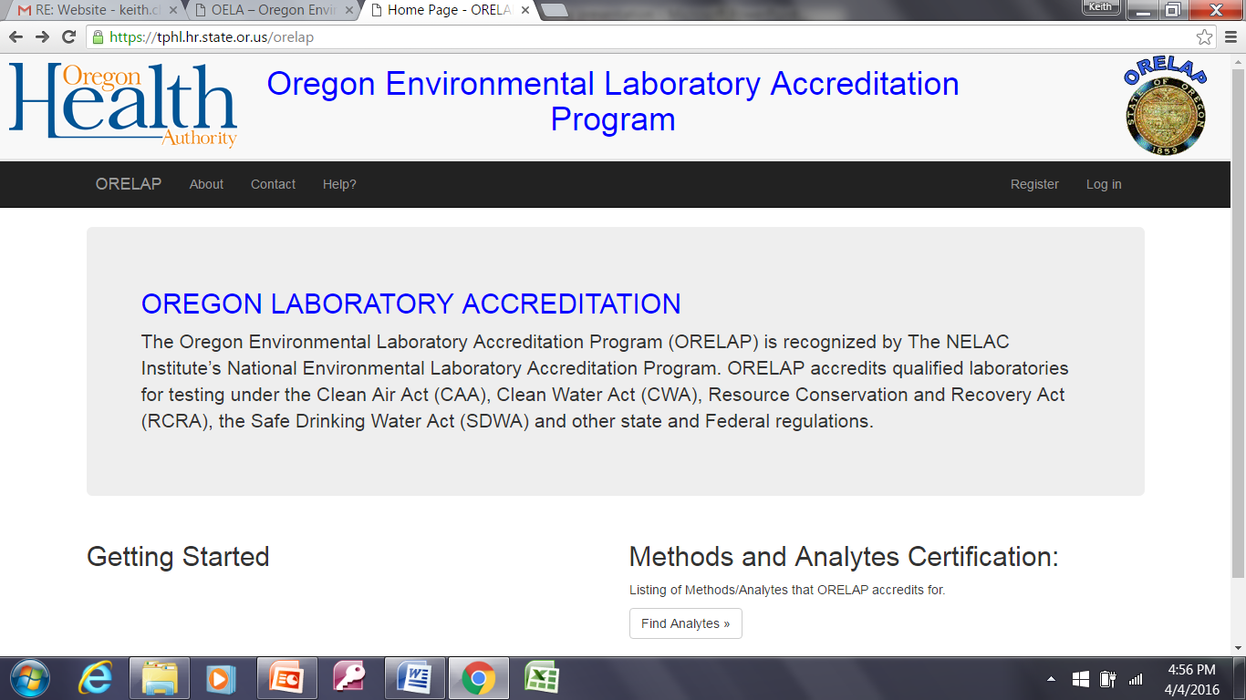

Slide 6
ORELAP
Stephanie Ringsage, OHA
Chris Redman, ORELAP
Scott Hoatson, DEQ/ORELAP
Lizbeth Garcia, ORELAP
Alia Servin, ORELAP
Ryan Pangelinan, ORELAP
RaeAnn Haynes, ORELAP
Heather Cayton, DEQ/ORELAP
Sophia Caggiano, DEQ/ORELAP

Slide 7
EXHIBITORS
Agilent Technologies
Astoria-Pacific
Environmental Express
Environmental Sampling Supply
EST Analytical
Idexx Laboratories, Inc.
Nurnberg Scientific
PerkinElmer, Inc.
Restek Corporation
Scion Instruments
Thermo Fisher Scientific
West Coast Scientific, Inc.
Zyomic Technologies

Slide 8
Overview: Morning
7:45 AM | Registration | OELA BOD Members
8:00 AM | Welcome, OELA Update OELA Membership Yearly Meeting Election of Board Members | Rory White OELA President
8:30 AM | ORELAP TECHNICAL ADVISORY COMMITTEE (OTAC) OTAC Update | Dennis Wells OTAC Chair BSK Associates
8:45 AM | ORELAP Introduction of ORELAP Personnel Program Update | Stephanie Ringsage, OHA, Manager, Laboratory Compliance Section
9:30 AM | Oregon Drinking Water Services Self-Introduction Program Update | David Emme, OHA Drinking Water Services Program Manager
10:00 AM | BREAK AND EXHIBITORS
10:30 AM | Oregon Drinking Water Services Electronic Compliance Data Reporting | Joe Carlson OHA Drinking Water Services Manager, Data Mgmt etc Charles Michael OHA Drinking Water Services Compliance Officer
11:00 AM | TNI Update Changes to the TNI Standard for Instrument Calibration and Detection and Quantitation Limits | Jerry Parr, Executive Director The NELAC Institute
Notes:
Morning Program

Slide 9
Overview: Early Afternoon
12:00 AM | LUNCH AND EXHIBITORS
1:30 PM | Room 1 – Laboratory Ethics | Gary Ward Ward Associates ORELAP Retired
1:30 PM | Room 2 – ODIE Update | Chris Redman ORELAP Program Manager
2:00 PM | Room 1 – EPA Alternate Test Procedures | Scott Hoatson Agency Quality Assurance Officer Oregon DEQ
2:00 PM | Room 2 - ODE Lead and Other Testing In Schools | Morgan Allen Deputy Executive Director Confederation of Oregon School Administrators
2:30 PM | Room 1 – DEQ new NPDES Permit Requirements and Electronic Reporting | Spencer Bohaboy Policy Development Specialist, DEQ Water Quality Permitting and Policy Development
2:30 PM | Room 2 – Oregon OSHA on Lab Safety | Daniel Cain PFO Consultation Manager Oregon OSHA
Notes:
Afternoon program

Slide 10
Overview: Late Afternoon
3:00 PM | BREAK AND EXHIBITORS
3:30 PM | Q&A Panel with the ORELAP and DEQ Assessors | Chris Redman, ORELAP Lizbeth Garcia, ORELAP Alia Servin, ORELAP Ryan Pangelinan, ORELAP RaeAnn Haynes, ORELAP Heather Cayton, DEQ Sophia Caggiano, DEQ
 | VISIT WITH EXHIBITORS UNTIL 5:00 PM
Notes:
Afternoon program

Slide 11
Electronic Certificate of Attendance Available
Notes:
There will be a sign up list for these certificates of attendance.

Slide 12
OELA Board Election
Rory White, Consultant, OTAC Member
Kim Ramsey, Neilson Research Corporation
Sherri Miyazaki, Box R Water Analysis Lab
Gary Buhler, Northwestern Aquatic Sciences
Jennifer Shackelford, City of Portland Water Pollution Control Laboratory
Notes:
Persons residing or employed in the State of Oregon who are engaged in the operation of or who are employees of an environmental laboratory, or who are engaged in providing support, supplies or services to environmental Labs.

Slide 13
OELA 2017 Ballot for Board of Directors
VOTE FOR FIVE
1
2
3
4
5

