Slide 1
Compliance Monitoring Data Portal (CMDP)
Joe Carlson & Chuck Michael
Data management, compliance and enforcement (DMCE)
Oregon Drinking Water services

Slide 2
Agenda
Note:
We are just learning the process too. We may not have all the answers to your questions.
Overview of CMDP
How to get an account/access
Methods to submit
Foreseen problems
Going forward

Slide 3
Overview of CMDP
What is CMDP?
A change in submitting sample results to state drinking water agencies from paper to electronic.

Slide 4
Overview of CMDP
CMDP is CROMERR complaint!
CROMERR: CROss-Media Electronic Reporting Rule
This is the federal legal framework for electronic reporting
What does that mean to you?
1 user per account – DO NOT SHARE!
Electronic reporting that meets federal law requirements

Slide 5
Overview of CMDP
Benefits:
If you report to multiple states, 1 location nationwide to report once the state has signed up.
If you subcontract a sample and both labs are registered:
Primary lab can enter the water system information
Subcontracted lab enters the analytical results
You can search for what samples have been submitted.
When final, there will be a training environment and a production environment

Slide 6
Overview of CMDP
CMDP training and help desk:
cmdp.zendesk.com

Slide 7
Notes:
Note: CMDP is programed to include access for water systems. Oregon is currently only looking at lab access.

Slide 8
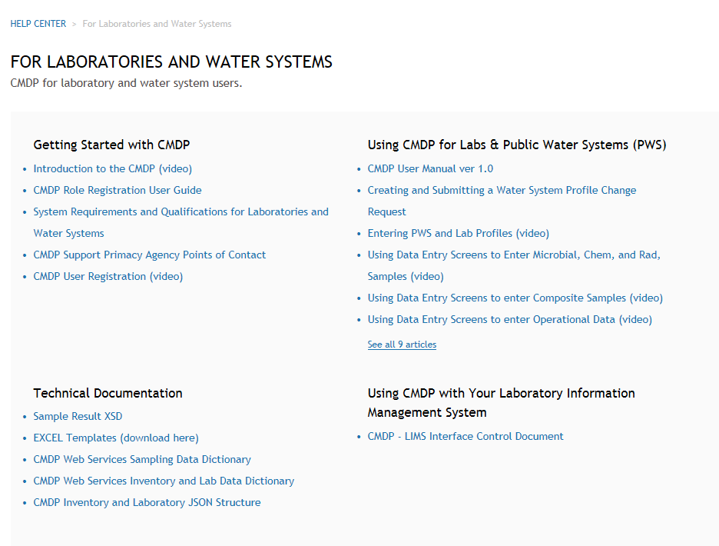

Slide 9
How to get an account / access
The Lab Administrator will request an account.
Send Email to dwp.dmce@state.or.us
Include the following:
Subject line ~ CMDP account request
First & Last Name (can’t use first initial)
Lab your are requesting to be administrator for
Email address for individual user

Slide 10
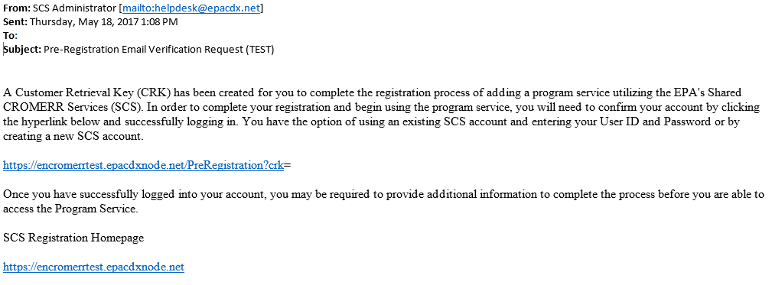
How to get an account / access
After we set up your basic account you will get an email with link to finish creating the account:
Save for future log in

Slide 11
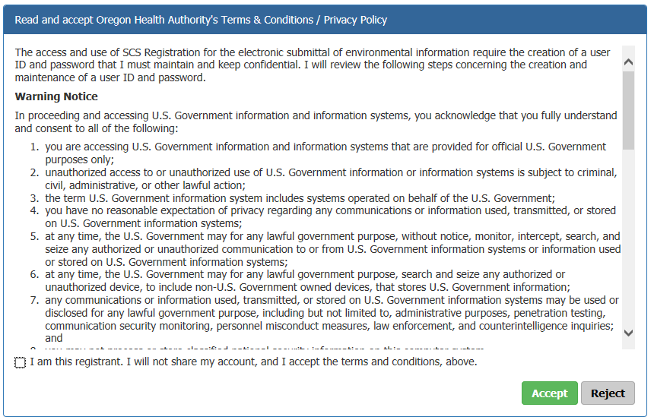
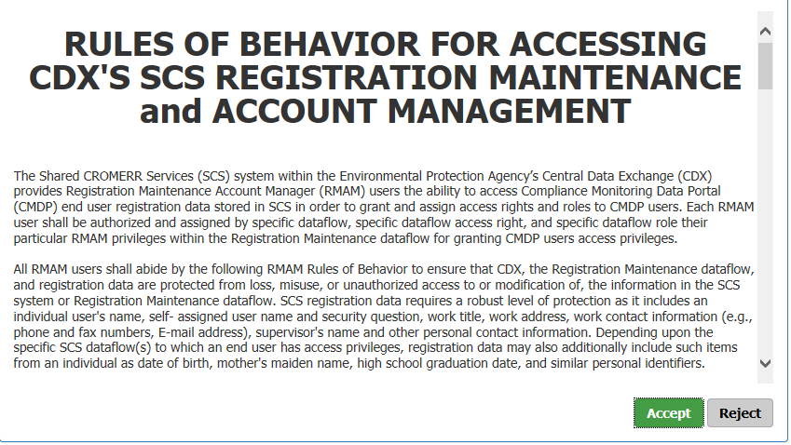
How to get an account / access

Slide 12
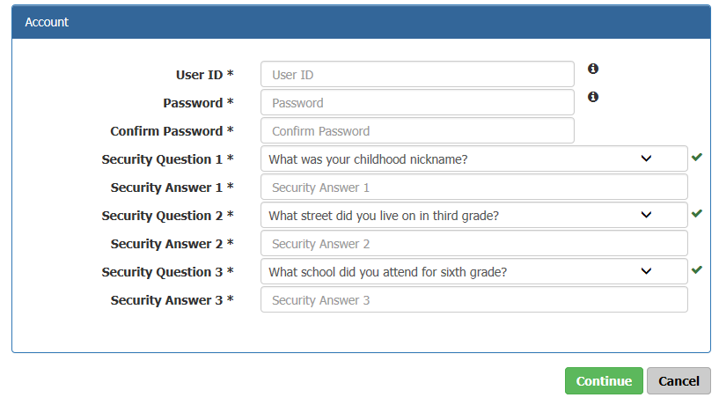
How to get an account / access
TIPS:
For test environment add test to your user name
Use short/easy answers
Save the answers somewhere

Slide 13
How to get an account / access
There are some additional steps including 5 more question/answer sets, an email verification and a 3rd agreement document (this one for electronic signatures)

Slide 14
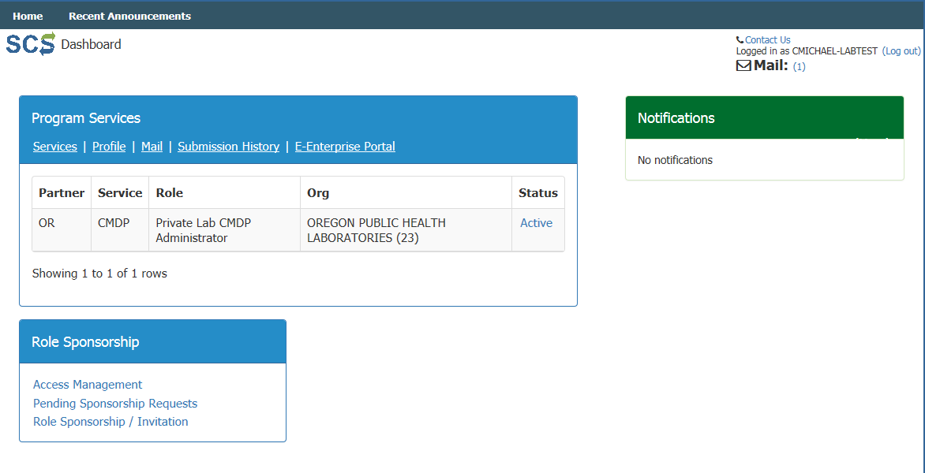
How to get an account / access
Done – now you are ready for testing!
Add coworkers in for testing also.
Enter samples by hand or excel

Slide 15
User levels
All users: can search for samples/jobs entered by your lab
Preparer: can enter samples/results for review
Reviewer: Preparer capabilities and review entries for accuracy
Certifier: Reviewer capabilities and Certify (submit) to state
System Administrator : Certifier capabilities; can add/remove users; and request changes to the lab profile.

Slide 16
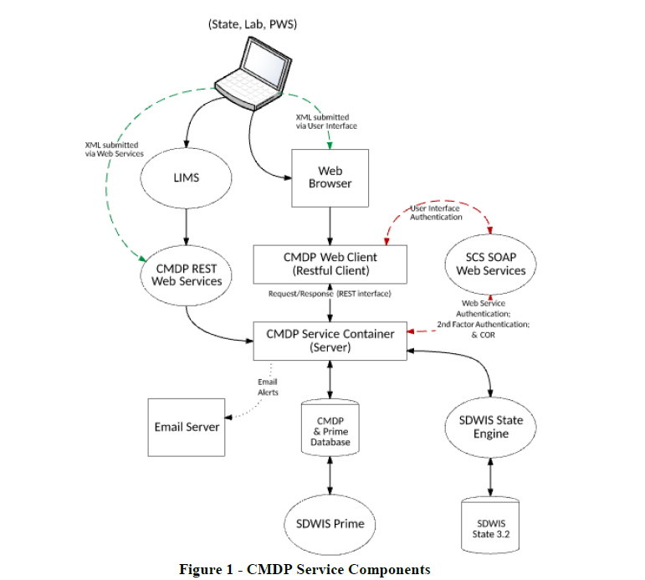
(PWS SCADA)
How EPA sees CMDP
Excel template

Slide 17
Methods to submit
LIMS
Spreadsheet (excel)
Entry in webpage
Computer programmers can set up a extract process to get the data straight out of your LIMS database
For those with a LIMS system, you will only need to handle the data one time – fewer chances of errors
Use of a predefined format for data. User logs in and submits data.
Data gets converted to an XML format for submittal and processing
Need to make sure to download and use most current version each time.
Log into CMDP and enter all sample results using online form
Error checks are built in and displayed at time of entry – not afterward as with other submittals.

Slide 19
Foreseen Problems:
New water systems not in SDWIS
Can’t be entered until system is setup by DWS staff. This can be a lengthy process and may be best to send the results in to DWS.
Assessment samples (GWR)
Assessment is not a sample type in SDWIS. It gets entered into SDWIS as a routine at a source and data online converts it to assessment

Slide 20
Foreseen Problems – Sample points:
Dist-a (Distribution):
All other facilities:
DBP’s –Approved locations listed on data online with sample point ID (2DBP-##).
For coliform, LCR and unapproved DBP locations use “A”
Use sample point “1”
Sources (SRC-)
Common headers (CH-)
Treatment plants (WTP-)
Entry points (EP-)

Slide 21
As we move forward…
Testing of CMDP:
By labs – can you get samples in?
By DWS – can we get the submitted samples into our database
Procedures:
How do we treat errors – ones by water systems and in data entry?
Any others identified during testing?

Slide 22
As we move forward…
After testing is complete:
State will move to production
Test environment will still be maintained for lab use and any upgrades
Lab ready to move to production: You will need to reregister in production environment

Slide 23
Questions:
Joseph Carlson
971-673-0470
Joseph.R.Carlson@state.or.us
Chuck Michael
971-673-0420
Charles.E.Michael@state.or.us

