Slide 1

Drinking Water Services
Program Update
Dave Emme
May 2017
.

Slide 2
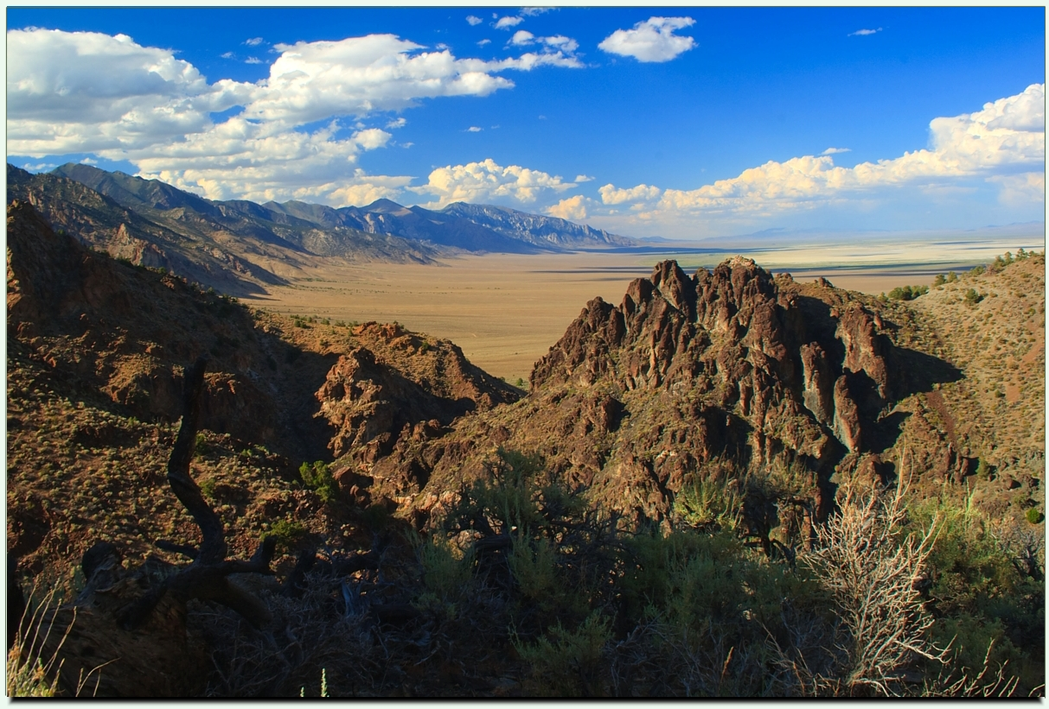

Slide 3
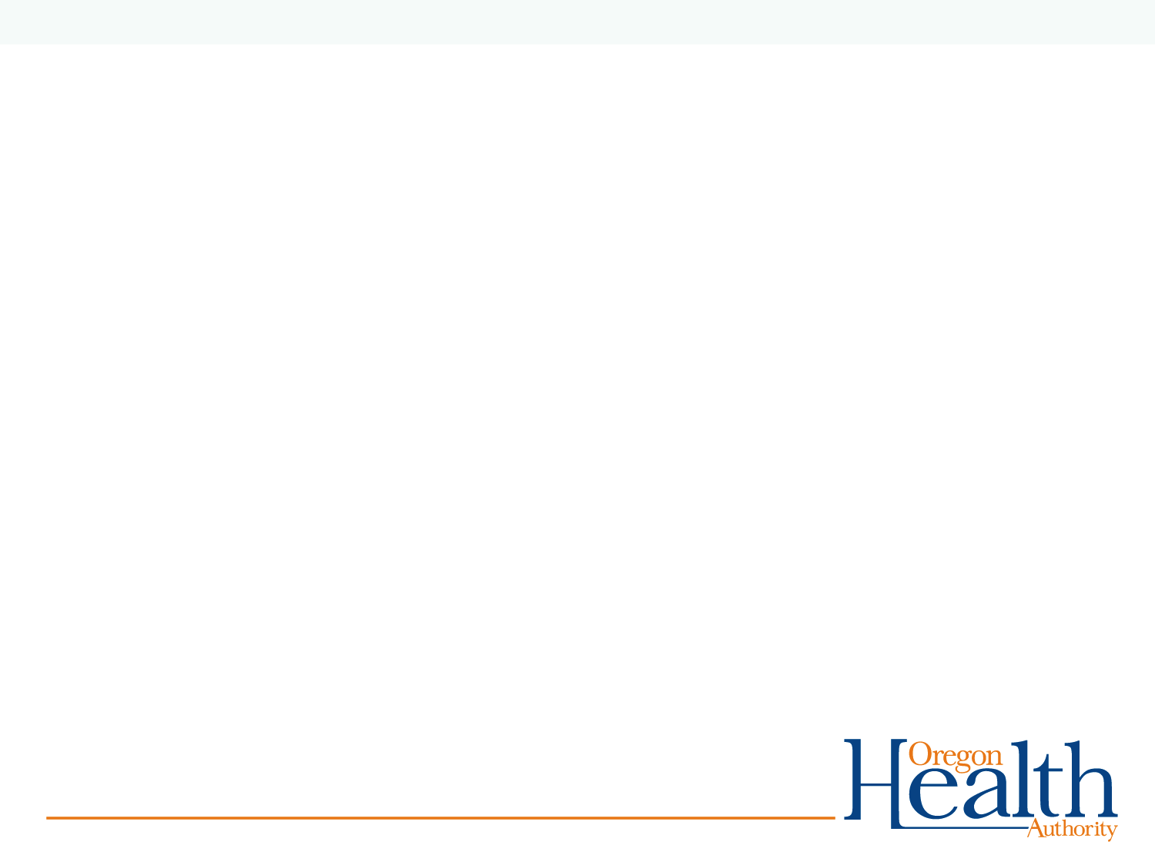
Outline.
Federal landscape
  Policy
  Budget
  EPA Regulation
Drinking Water program update
  Resources
  Accomplishments
  Areas of Focus

Slide 4
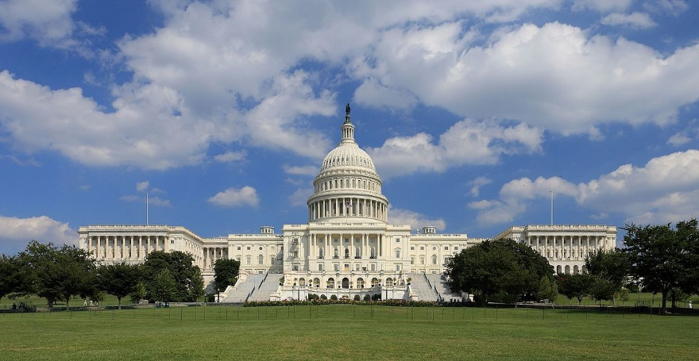
Federal Landscape

Slide 5
Executive Orders
EO 13771 REDUCING REGULATION AND CONTROLLING REGULATORY COSTS, January 30, 2017
  Unless prohibited by law, no new regulations unless offset by repeal of two existing regulations.
  Net zero cost of new regulations.

Slide 6
Executive Orders
EO 13777 ENFORCING THE REGULATORY REFORM AGENDA, February 24, 2017
  Agencies to designate Regulatory Reform Officer and Regulatory Reform Task Force to identify regulations for repeal or replacement that:
    Eliminate jobs or inhibit job growth
    Are outdated or unnecessary;
    Costs exceed benefits;
    Derive from prior rescinded Executive Orders
  FR notice 4/13/17 solicited public comments. 72,385 comments received.

Slide 7
Executive Orders
EO 13781 COMPREHENSIVE PLAN FOR REORGANIZING THE EXECUTIVE BRANCH, March 13, 2017
  Agencies to submit reorganization plans within 180 days.
  OMB to solicit public suggestions for reorg.
  OMB to submit an overall Plan that considers:
    Whether States can perform the function;
    Elimination of redundant functions;
    Whether benefits justify costs;
    Costs of shutting down or merging agencies, programs or functions.

Slide 8
Federal Budget
Continuing Resolution funds Agencies through September 30, 2017.
Steep cuts to EPA proposed for 2018.
Still early, Congress to decide, another CR is also possible…

Slide 9
EPA budget trend 1980-2018

Slide 10
EPA Policy and Regulatory Outlook
Themes from EPA Administrator Scott Pruitt:
The Rule of Law Matters – perceived overreach of statutory authority
Process Matters – reaction to sue then settle
Cooperative Federalism as a Guiding Principle – deference to States as primary implementers

Slide 11
EPA Policy and Regulatory Outlook
Drinking Water program
Still a priority, but resources will be constrained at both the Federal and State level.
Continued support for State Revolving loan fund program.

Slide 12
EPA Drinking Water Standards Process
Contaminant Candidate List
EPA to publish list every 5 yrs.
Contaminants known or suspected to occur in DW
Regulatory Determination
EPA must determine whether to regulate at least 5 from latest CCL (every 5 yrs).
3 Criteria used:
  Adverse health effect
  Known or likely to occur at levels of concern
  Meaningful opportunity for health risk reduction
Unregulated Contaminant Monitoring Rule
Collect data on contaminants suspected to be present in DW
Up to 30 contaminants every 5 yrs
Development of Standard
Notes:
This is the rigorous process set out in the 1996 amendments. First determine whether to regulate.

Slide 13
EPA Drinking Water Program Outlook
Unregulated Contaminant Monitoring
  UCMR 3 monitoring completed 2015-16 and posted in January 2017, included:
    28 chemicals and 2 viruses. Including perfluorinated (PFOA/PFOS) compounds and hexavalent chromium.
  UCMR 4 monitoring to take place 2018-20, includes 10 cyanotoxins and 20 additional chemicals.

Slide 14
EPA Drinking Water Program Outlook
Continued focus on lead and reducing exposure.
Lead and Copper Rule revisions. EPA White Paper.
    LSL replacement
    Improved Optimal corrosion control treatment
    Health-based benchmark for lead
    Clarify and strengthen sampling requirements
    Increased transparency
    Decouple copper from lead
Perchlorate proposed MCL by Oct 31, 2018
  Low concentrations in some wells in Lower Umatilla Basin.
  Big issue in NV and the lower Colorado River.

Slide 15
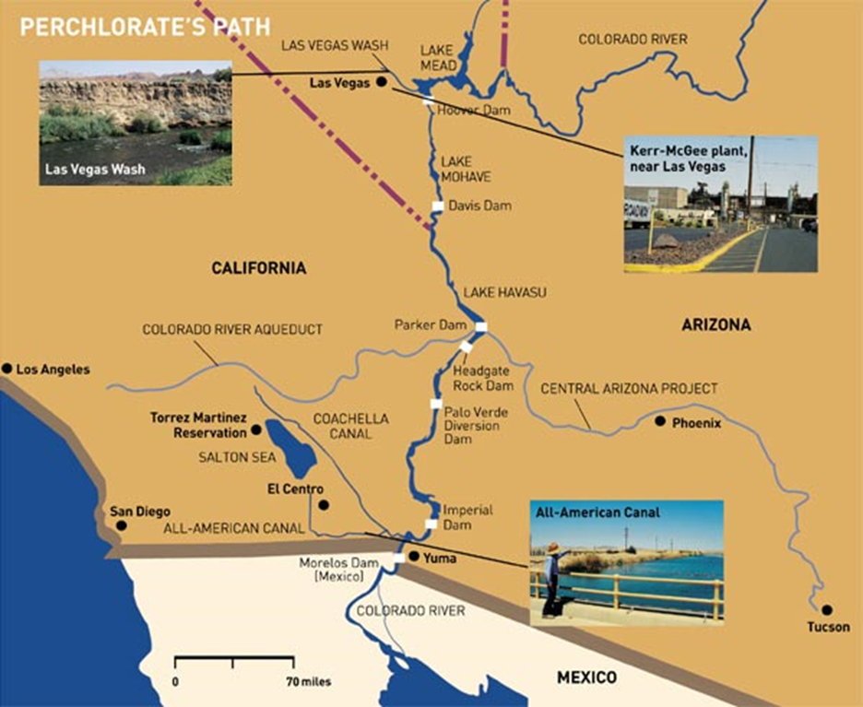

Slide 16

Oregon Drinking Water program update

Slide 17
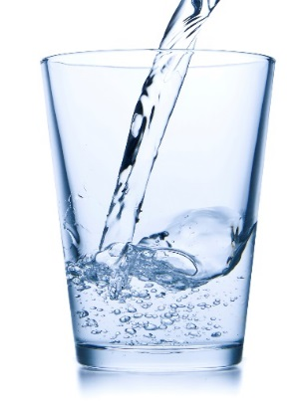
Oregon Drinking Water Program
Rules and Health-based Standards
Source Water Assessment and Protection
Assess Monitoring Reports
Grant & Data
Contract Mgt.
Admin.
Technical and Financial Assistance
Investigate Contaminants
Enforcement
On-site Sanitary Surveys
Plan Review
Certification of Operators, Testers, Labs

Slide 18
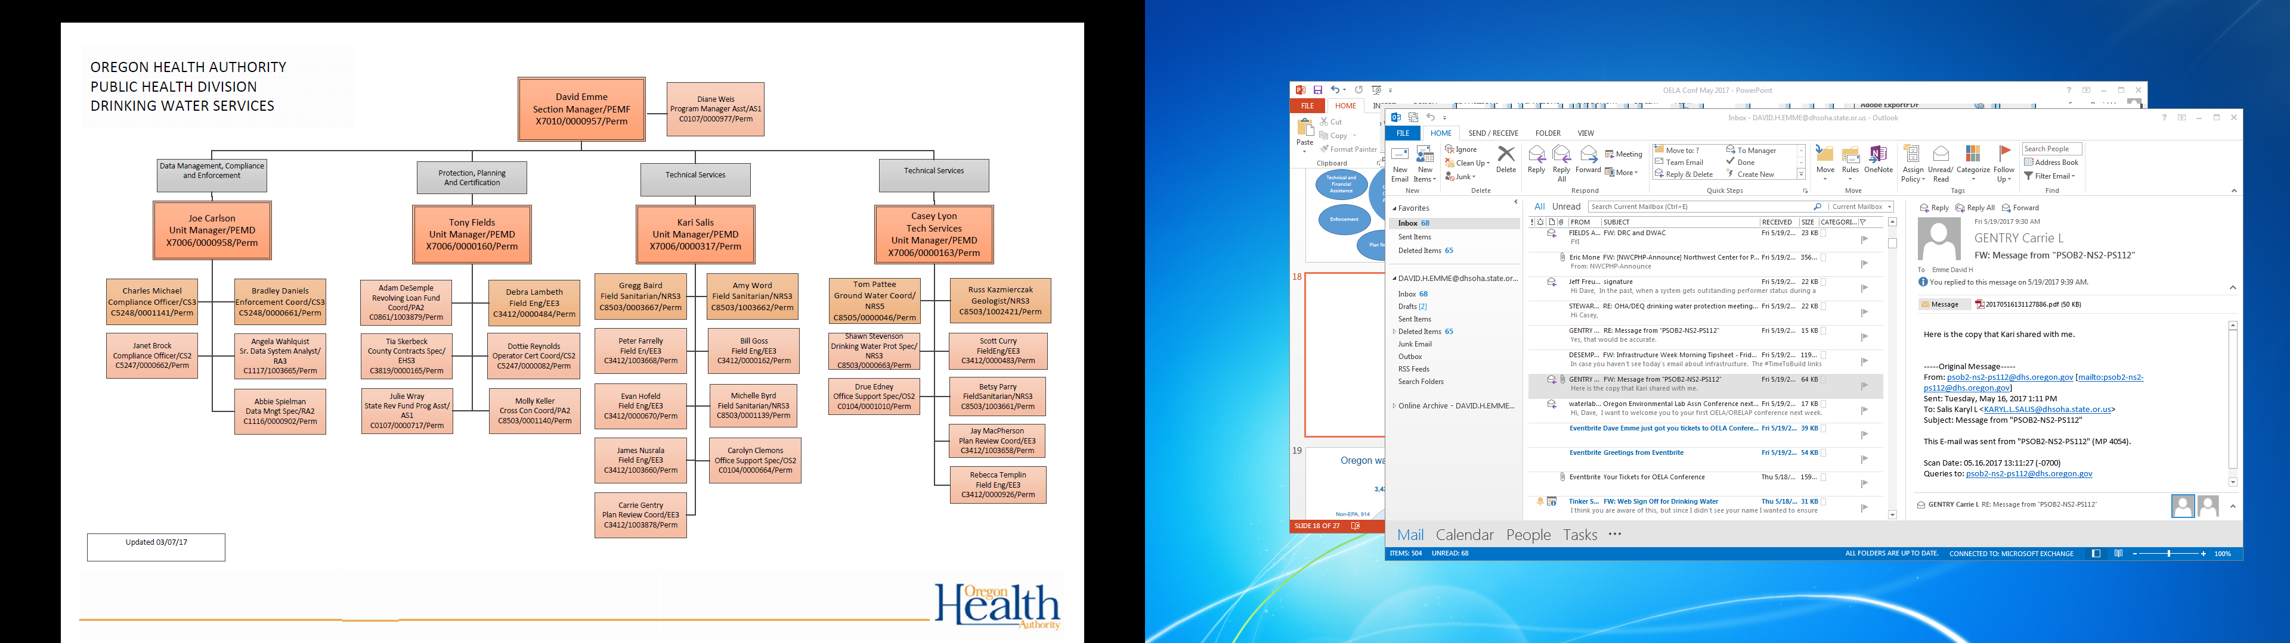

Slide 19
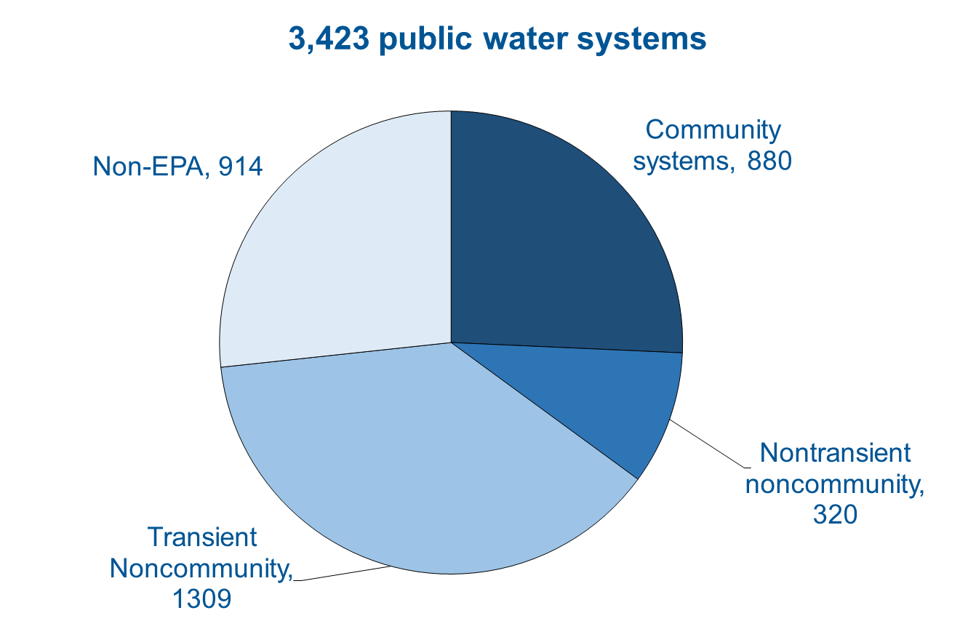
Oregon water systems by type

Slide 20
DWS Revenue Sources FY15-17

Slide 21
DWS Expenditure Categories FY15-17

Slide 22
DWS FTE Trends—35% reduction from 2009

Slide 23
Notes:
National performance measure – system based. Generated by EPA annually from state data submitted. Oregon historically underperformed with respect to national levels, with clear disparity for small system safety. That disparity is much improved in recent years, as promised in 2007 Legislature staffing increase! 2015 – met EPA goal!

Slide 24
Compliance progress, but still work to do…
In the past year:
  1606 contaminant alerts
  25 Level 2 investigations for E. coli.
  20 lead and copper exceedances
  3 arsenic exceedances
  3 nitrate exceedances
215 unaddressed violations currently.
6 boil water advisories currently.

Slide 25
Drinking Water Services--Areas of focus
Continued focus on Lead.
Approved a schedule for improved corrosion control in Portland.
Conducting on-site reviews of LCR compliance at large systems.
On-going assistance to ODE related to lead in schools.

Slide 26
Drinking Water Services--Areas of focus
Surface Water systems/Microbials.
Implementation of Revised Total Coliform Rule.
LT2 Rule. Portland to install Crypto treatment.
On-going assistance to systems through Optimization program.

Slide 27
Drinking Water Services--Areas of focus
Small system compliance issues.
Over 90% of OR public water systems serve fewer than 500 people.
Tracking and follow-up of Priority Non-Compliers.
Targeted technical and financial assistance.

Slide 28
Drinking Water Services--Areas of focus
Business process improvements.
Expand electronic reporting.
State-County workgroup.
Long-term planning
  Possible repeal of non-EPA systems
  Revisit fee structure.

Slide 29
Drinking Water Services--Conclusions
Continued success is dependent on the contributions of many partners, including:
  EPA
  Local Health Dept’s
  Dept of Agriculture
  Oregon DEQ
  Infrastructure Financing Authority
  Technical assistance contractors
  Oregon Public Health lab

Slide 30
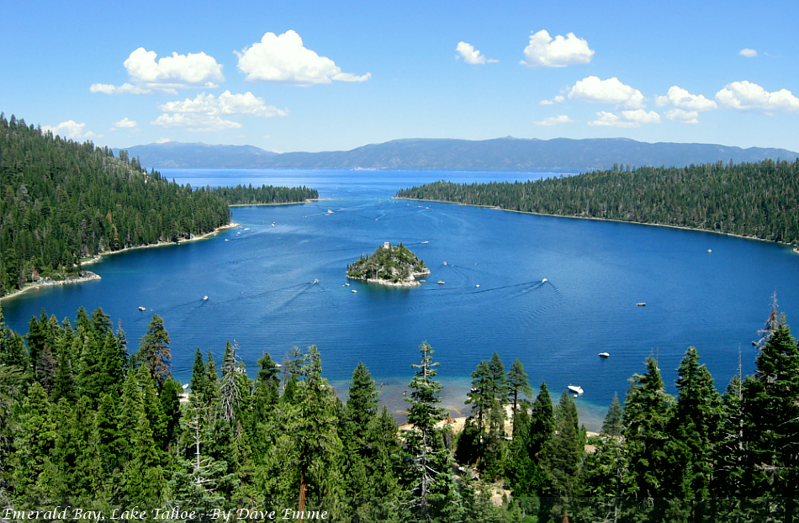
david.h.emme@state.or.us 971-673-0415

