Slide 1
Oregon Environmental Laboratory Conference: How DEQ Uses Analytical Data From Point Sources to Protect Water Quality
Spencer Bohaboy Policy Development Specialist
Water Quality Policy

Slide 2
Introduction
Permit Development Process
Reasonable Potential Analysis
Water Quality Based Effluent Limits
Permit requirements
Schedule A & B
Compliance
Gap analysis and other data requests

Slide 3
Introduction
Mostly will be talking about facilities >1 MGD
Major Facilities
Facilities < 1 MGD require a lot less in terms of permit development and analytical monitoring
Minor Facilities

Slide 4
Permit Development Process
Reasonable Potential Analysis
A site specific water quality-based evaluation that models the impacts of a discharge on the receiving water body
Uses various water quality models to evaluate water quality criteria for toxicity, temperature, pH, dissolved oxygen, ammonia, etc.
Effluent Data
Conventional: Normally semi-continuous Chlorine, Ammonia, BOD, TSS, etc. data
Toxics: Normally 4 Priority Pollutant Scans (>170 parameters)
Copper and Aluminum BLM: Cu and Al plus a suit of conventional paramaters
Ambient Data
Determine site specific water quality criteria: hardness, pH, temp., phosphorous, conductivity, etc.
Calculate assimilative capacity: Indicated pollutant parameters
Develops a worst case scenario and determines if there is a reasonable potential that the water quality standards are exceeded at the edge of the mixing zone (if applicable)
Notes:
Trying to set up the current atmosphere in the Water Quality Program and point out what will affect laboratories
Data is one of the major themes. As permits grow increasingly more complex, the availability of good data becomes a key factor in being able to issue a permit in a timely manner.

Slide 5
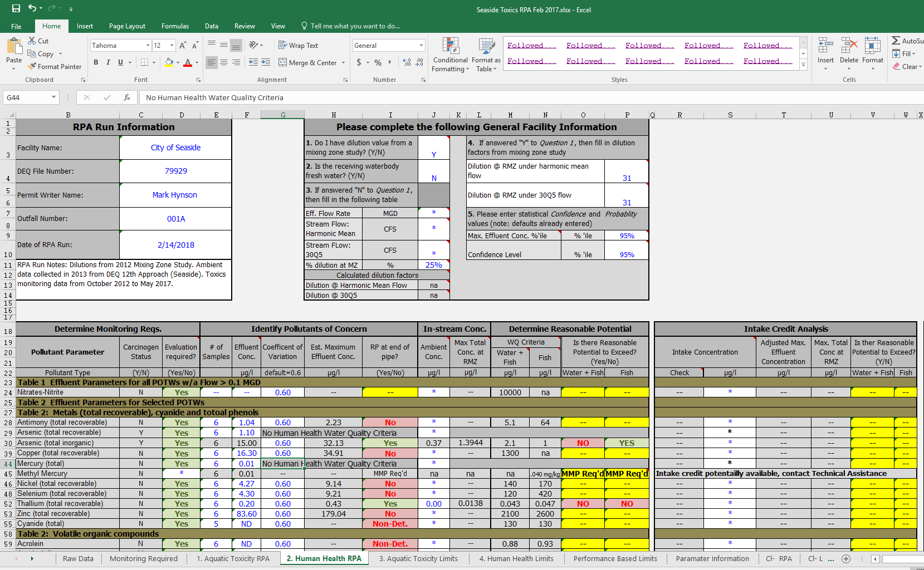
RPA Example: RP Deter. Toxics

Slide 6
Permit Development Process
Effluent Limits
Where “Reasonable Potential” is determined, limits are required
TBELs: Technology Based Effluent Limits serve as the minimum amount of treatment for conventional parameters
WQBELs: Water Quality Based Effluent Limits reflect an evaluation of both the discharge and the receiving water body to meet water quality standards
Effluent flow rates, pollutant concentrations, ambient flow rates, pollutant concentrations
Other: Some times there are other effluent limits developed from WET test, from basin standards, TMDLs or industrial sector requirements
Schedule A of the Permit

Slide 7
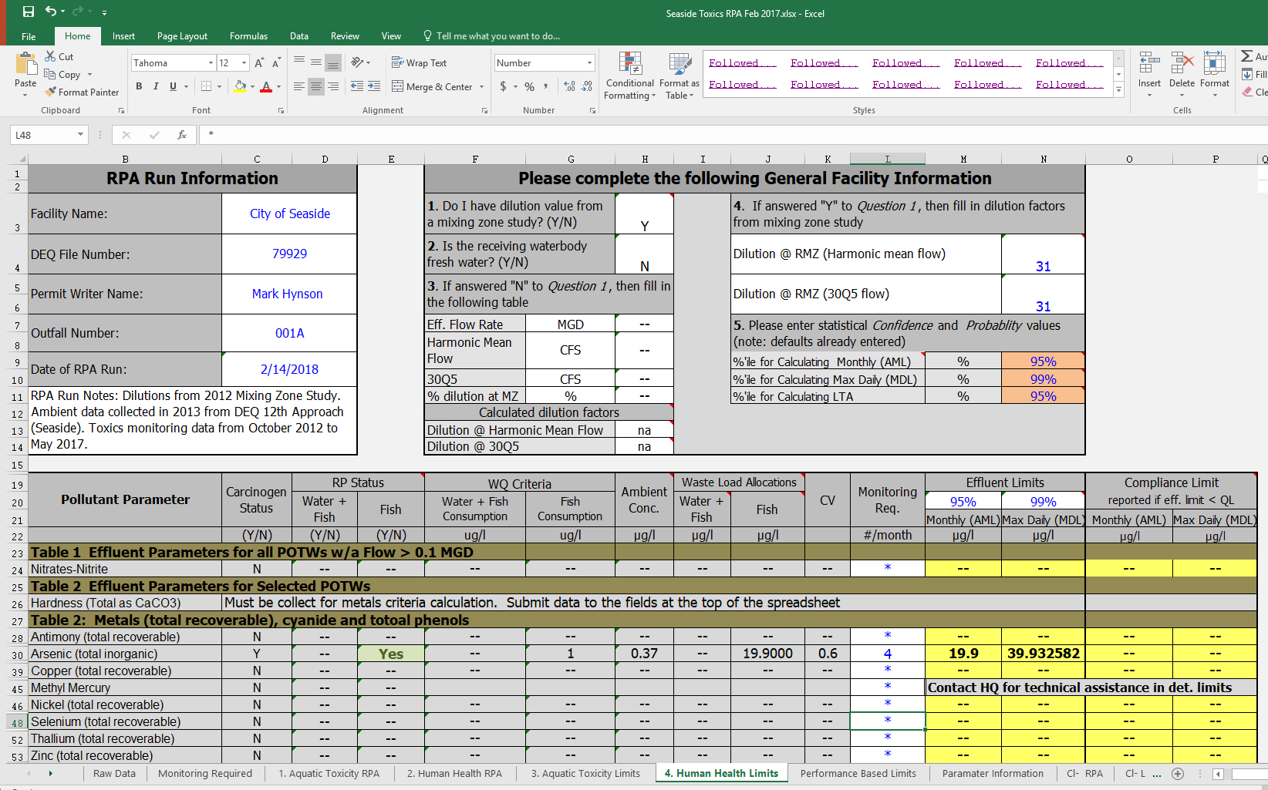
RPA Example: WQBEL Calculation

Slide 8
Permit Requirements
Schedule A
Discharge Compliance limits
Conventional parameters: TSS, BOD, pH, Bacteria, Chlorine, Ammonia
Specific parameters where criteria might be exceeded: Toxics
Ground water, recycled water and biosolids limits
Mercury Minimization Plan requirements

Slide 9
Schedule A

Slide 10
Permit Requirements
Schedule B
Monitoring requirements to both determine compliance and characterize effluent/ambient for future permit development
Information regarding required minimum analytical limits
Analytical Limits are very important since in many cases they become the default effluent limits
Need to report both Quantitation Limits (MRL) and Detection Limits
Getting much more data intensive in a short period of time
From a minimum of 4 data points, now often ask for 10 or more
Copper and Aluminum Biotic Ligand Model
Site specific criteria for ammonia, dissolved metals, Copper and Aluminum
Can be submitted in a variety of manners
E-reporting
E-reporting with attached spreadsheets
Electronic Data Delivery: Cd’s of data to DEQ Lab

Slide 11
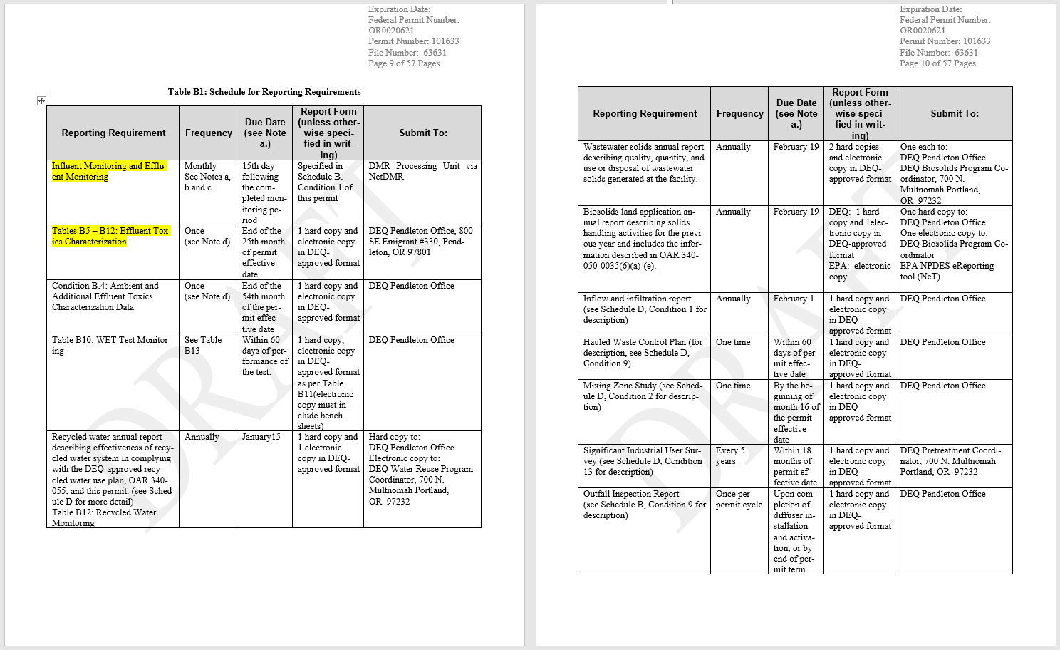
Schedule B

Slide 12
Schedule B

Slide 13
Compliance
For each effluent limit in Schedule A, the permittee collect monitoring data and submits to the department
Past (partial present): Submit monitoring data on paper Discharge Monitoring Reports
The DMRs would get keyed into the DEQ database by hand to determine compliance
Present: Submit monitoring data directly to DEQ/EPA database (EPA-Net)
Minimizes “fat finger” errors and is more efficient
Allows for laboratories to direct submit data pending client review and e-signature

Slide 14
Gap Analysis and Other Data Requests
Permitting is a changing environment
New criteria, TMDLs, water quality listings, federal requirements, etc. often mean that permit writers need data that is not included in the current permit
Permit backlog often means that data collected for a facility might not be appropriate in terms of size of data set or analytic limit
Department is working on a formal “gap analysis process” to identify where additional data is necessary
Department currently has informal processes to identify additional monitoring requirements
Tier II monitoring
Permit writer discretion
Permit writer will issue the permittee a letter or order requiring additional monitoring

Slide 15
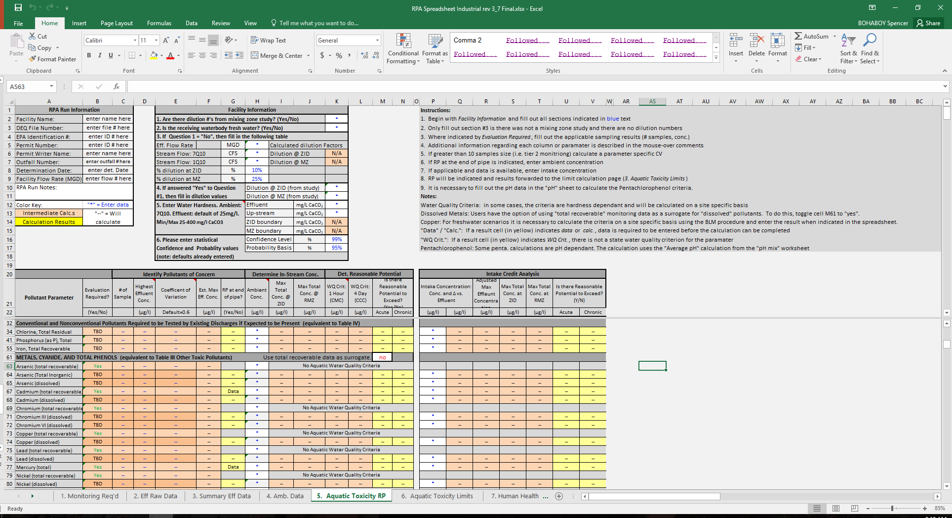
RPA Example

Slide 16
Questions
Spencer Bohaboy
Policy Development Specialist
Water Quality Permit and Policy Development
503-229-5415
Bohaboy.Spencer@DEQ.state.or.us

