Slide 1
OELA/ORELAP Environmental Laboratory Conference April 17th, 2018

Slide 2
Welcome Oregon Environmental Laboratories!
Notes:
OELA organizes this meeting “periodically” to facilitate the exchange of information with ORELAP and TNI. Again this year we have Jerry Parr, the Executive Director of The NELAC Institute.

Slide 3
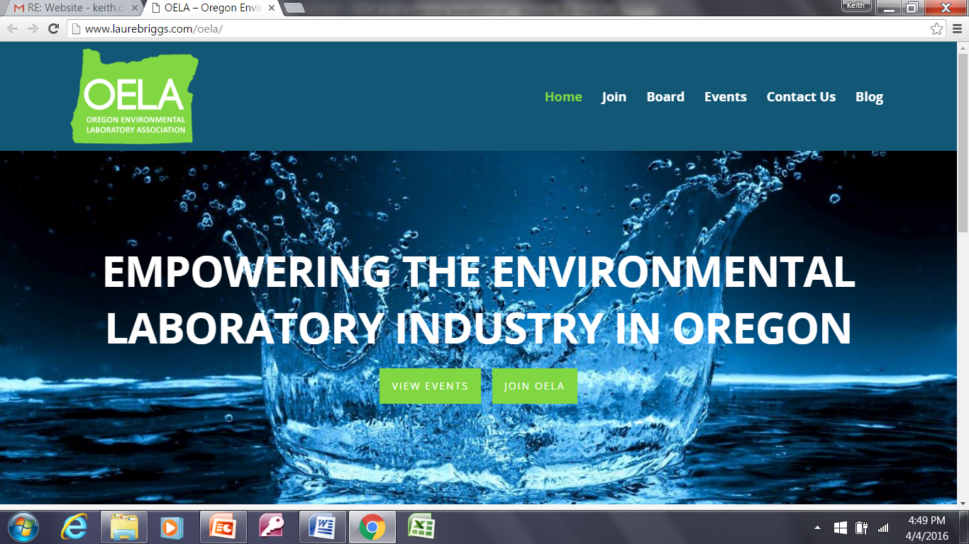
Notes:
oelaonline.com
Persons residing or employed in the State of Oregon who are engaged in the operation of or who are employees of an environmental laboratory, or who are engaged in providing support or services to environmental Labs.

Slide 4
OELA Board
Rory White, President
Kim Ramsey, Vice President
Beth Myers, Secretary/Treasurer
Bill Michalek, OTAC Representative
Dennis Morgan
Jan Wilson
Sherri Miyazaki
Gary Buhler
Jennifer Shackelford
Kyle Grogan
Marsha Farooqui

Slide 5
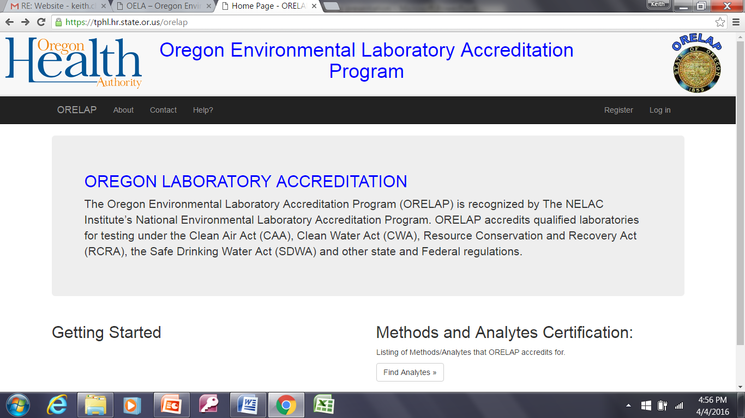

Slide 6
ORELAP
Stephanie Ringsage, OHA
Lizbeth Garcia, ORELAP
Alia Servin, ORELAP
Ryan Pangelinan, ORELAP

Slide 7
EXHIBITORS
Agilent Technologies
Astoria-Pacific
Bio-Rad Laboratories
Cole-Parmer
CPI International
ERA, A Waters Company
EST Analytical
GE Healthcare
Hach Company
Millipore Sigma
Nurnberg Scientific / Sheldon Manufacturing
PerkinElmer, Inc.
Questron Technologies / Zyomic Technologies
Shimadzu Scientific Instruments
Thermo Fisher Scientific
West Coast Scientific, Inc.

Slide 8
Overview: Morning
7:30 AM | Registration | OELA BOD Members
8:00 AM | Welcome, OELA Update OELA Membership Yearly Meeting Adoption of OELA Code of Ethics Election of Board Members Introduction of Exhibitors | Rory White OELA President
8:30 AM | ORELAP TECHNICAL ADVISORY COMMITTEE (OTAC) OTAC Update | Dennis Wells OTAC Chair Cascadia Labs
8:45 AM | Oregon Laboratory Accreditation Program (ORELAP) Program Update | Stephanie Ringsage, OHA, Manager, Laboratory Compliance Section
9:30 AM | Oregon Drinking Water Services Challenges for Drinking Water Regulation in 2018 | David Emme OHA Drinking Water Services Program Manager
10:00 AM | BREAK AND EXHIBITORS
10:30 AM | Legislation Made Simple… …Sort Of | Rep. Carl Wilson Oregon House of Representatives
11:00 AM | TNI Update Changes to the Quality Systems Module in the 2016 TNI Standard | Lee Wolf TNI Ambassador to the Northwest The NELAC Institute
Notes:
Morning Program

Slide 9
Overview: Early Afternoon
12:00 AM | LUNCH AND EXHIBITORS
1:30 PM | Room 1 – Laboratory Ethics | Kristen Thomas Laboratory Coordinator City of Portland Water Pollution Control Laboratory
1:30 PM | Room 2 – The Benefits & Pitfalls of Automation, Alternate Test Procedures, and Extensive Cross Training for Production Gains in a Municipal Environmental Laboratory or ‘PRIDE GOETH BEFORE A FALL’ | Chuck Lytle Laboratory Manager City of Portland Water Pollution Control Laboratory
2:00 PM | Room 1 – Method Update Rule and EPA Alternate Test Procedures | Donald Brown Regional Quality Assurance Manager EPA Region 10
2:00 PM | Room 2 – One Lab’s Experience: Case Study in Corrective Action Reports | Jennifer Shackelford QAQC Coordinator City of Portland Water Pollution Control Laboratory
2:30 PM | Room 1 – DEQ NPDES Permits: Updates and Analytes | Spencer Bohaboy Policy Development Specialist Oregon DEQ
2:30 PM | Room 2 – Oregon OSHA on Lab Safety | Chris James Senior Occupational Health Consultant Oregon OSHA
Notes:
Afternoon program

Slide 10
Overview: Late Afternoon
3:00 PM | BREAK AND EXHIBITORS
3:30 PM | Q&A Panel with the ORELAP Assessors OELA Moderator Kyle Grogan | Lizbeth Garcia Ryan Pangelinan Alia Servin
4:00 PM | VISIT WITH EXHIBITORS UNTIL 5:00 PM
Notes:
Afternoon program

Slide 11
Certificate of Attendance Available At Registration Table After 4:00
Notes:
There will be a sign up list for these certificates of attendance.

Slide 12
OELA Board Election
Beth Myers, Waterlab Corporation
Jan Wilson, Cammia Environmental
Bill Michalek, Umpqua Research Company
Dennis Morgan, Analytical Laboratory Group
Kyle Grogan, Neilson Research Corporation
Marsha Farooqui, City of Portland Water Bureau Laboratory
Notes:
Persons residing or employed in the State of Oregon who are engaged in the operation of or who are employees of an environmental laboratory, or who are engaged in providing support, supplies or services to environmental Labs.

Slide 13
OELA Code of Ethics
Oregon Environmental Laboratory Association
Code of Ethics
All members of the Oregon Environmental Laboratory Association are committed to establishing and maintaining high standards of ethics and quality in our industry. Individual members and member laboratories demonstrate their continuing commitment to ethics and quality by agreeing to:
Build on existing Association relationships with state and local agencies. Promote open and timely communication between government regulators and the regulated community.
Increase client knowledge. Educate clients regarding technical issues as well as their legal and ethical rights and responsibilities.
Train employees appropriately. Ensure competency before allowing employees to perform sample preparation, chemical analysis or data generation.
Encourage all members of our industry to obey all pertinent federal, state and local laws and regulations. Lead by example.
Maintain laboratory facilities, equipment and instrumentation adequately to ensure the accuracy and precision of measurements.
Elevate the status of all environmental laboratories, their employees and the value of the services they perform.
Willingly participate in critical review through ORELAP, EPA and third party Performance Evaluation programs, agency audits and client challenges of data.
Accept work only when there exists a reasonable expectation that the client will gain something of value. Satisfy all commitments to quality, timeliness and other project objectives. Provide services in a confidential, honest and forthright manner.
To deal honestly and fairly in all business and financial matters with employees, clients and the public.
Legally and ethically manage laboratory waste. Make responsible decisions regarding disposal, recycling, reuse and minimization.
Treat clients, employees and the environment with respect. Operate facilities in a manner that protects the environment and the health and safety of employees and the public.

